Slide 1
CLOUD COMPUTING
ITA6009

Slide 2
Module:1 Introduction
Cloud models-Evolution of Cloud Computing –System Models for Distributed and Cloud Computing – NIST Cloud Computing Reference Architecture – On-demand Provisioning – Elasticity in Cloud – deployment models – service models-cloud service providers

Slide 3
Module:2 Virtualization
Basics of Virtualization - Types of Virtualization - Implementation Levels of Virtualization -Virtualization Structures - Tools and Mechanisms – resource sharing and resource pooling -Desktop Virtualization – Server Virtualization.
Module:3 Cloud Infrastructure Architectural Design of Compute and Storage Clouds – Layered Cloud Architecture Development – Design Challenges - Inter Cloud Resource Management – Resource Provisioning and Platform Deployment – Global Exchange of Cloud Resources.

Slide 4
Module:4 Programming Model
Parallel and Distributed Programming Paradigms – Map Reduce, Twister and Iterative Map Reduce – Hadoop Library from Apache – Mapping Applications - Programming Support.
Module:5 Security in the Cloud
Security Overview – Cloud Security Challenges – Access control mechanisms – Security Governance – Risk Management – Security Monitoring – Security Architecture Design – Virtual Machine Security.

Slide 5
Module:6 Enterprise Cloud-Based High Performance Computing (HPC)
Overview of High Performance Computing (HPC) on Cloud-Enterprises HPC applications (high-performance grid computing, high-performance big data computing/analytics, high performance reasoning)-HPC Cloud vendor solutions: compute grids (Windows HPC, Hadoop, Platform Symphony ,Gridgain), data grids (Oracle coherence, IBM Object grid, Cassendra, HBase, Memcached, HPChardware (GPGPU, SSD, Infiniband, Non-blocking switches)
Module:7 Setting up own Cloud cloud setup-How to build private cloud using open source tools-Understanding various cloud plugins-Setting up your own cloud environment-Autoprovisioning-Custom images-Integrating tools like Nagio-Integration of Public and Private cloud.
Module:8 Contemporary issues
Expert Talks

Slide 6
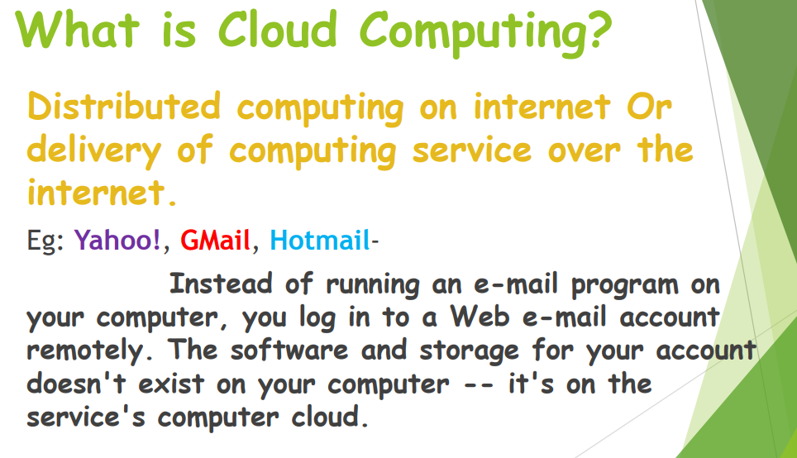

Slide 7
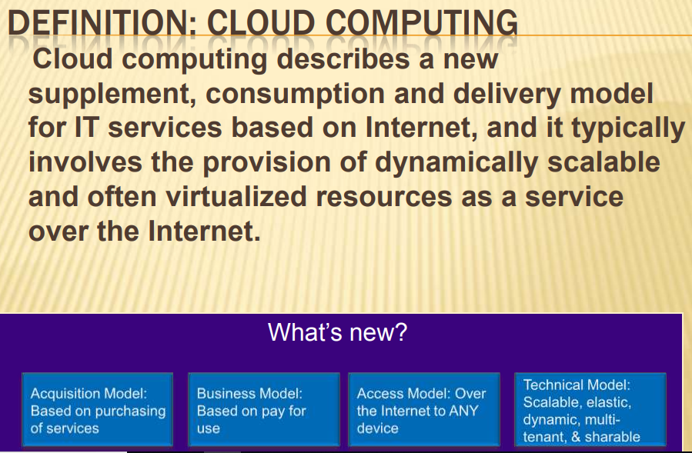

Slide 8
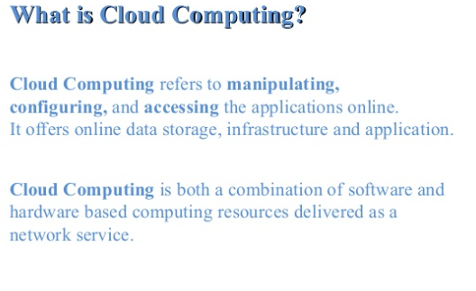

Slide 9
Who is founder of cloud computing?
Most of the time, Salesforce.com's Marc Benioff is credited with inventing the new cloud model for delivering software via the Web.
But Larry Ellison, who once famously denounced the term "cloud computing," is now standing up to take credit for the concept, if not the currently fashionable term.

Slide 10
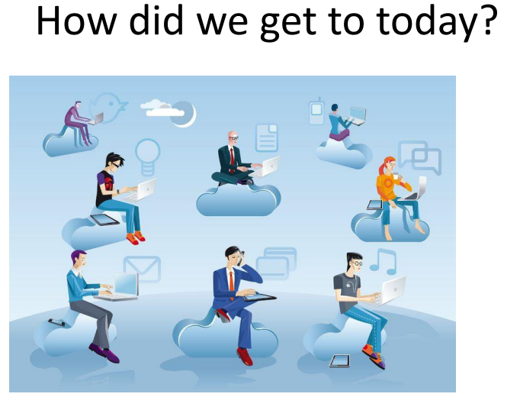

Slide 11
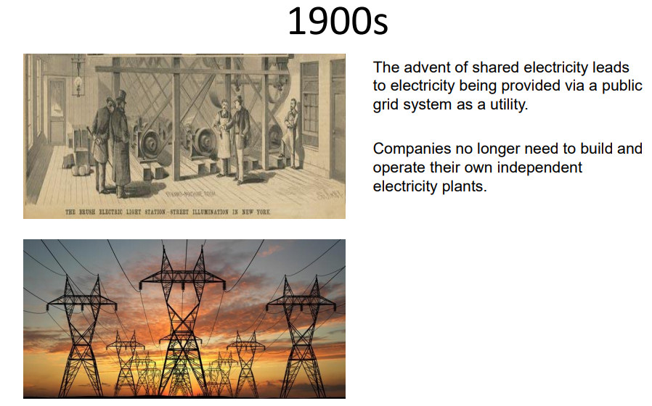

Slide 12
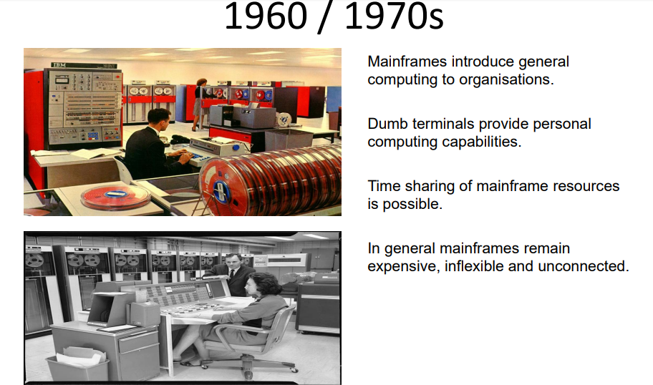

Slide 13
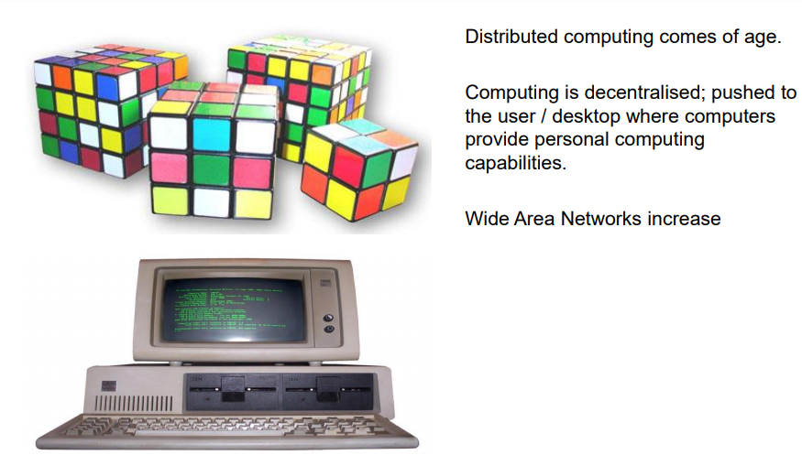
1980’S

Slide 14
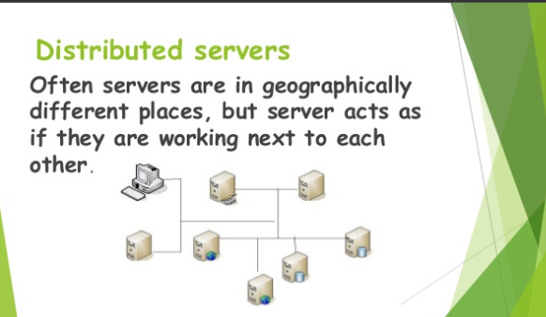

Slide 15
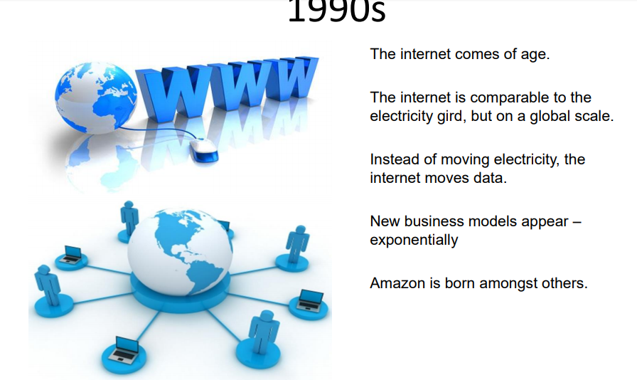

Slide 16
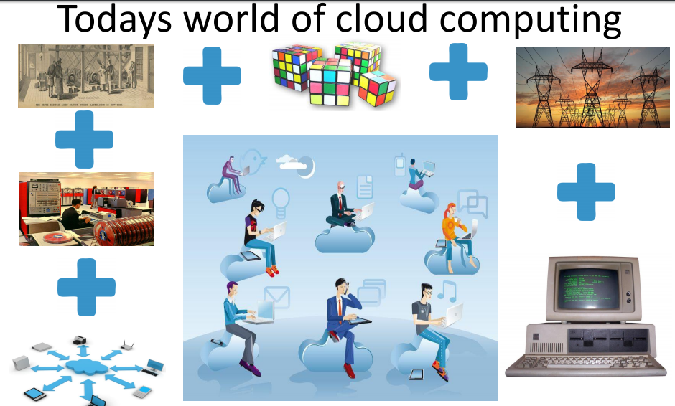

Slide 17
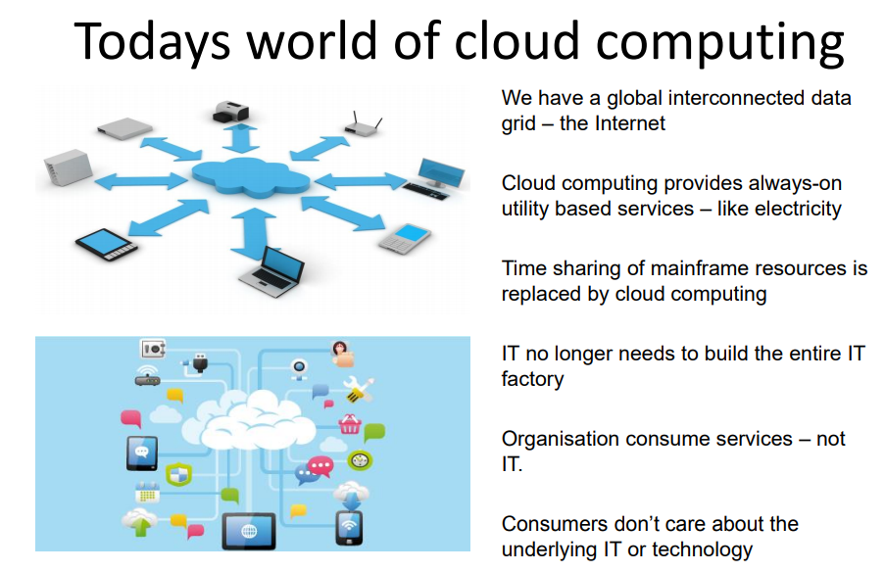

Slide 18
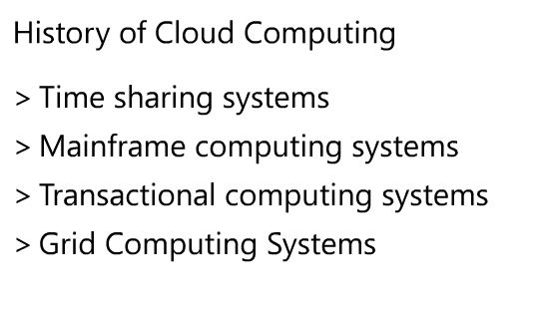

Slide 19
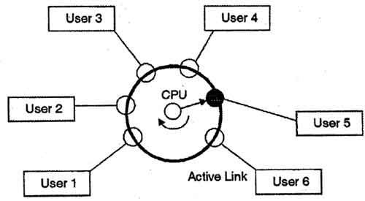
Time-sharing
Time-sharing is a technique which enables many people, located at various terminals, to use a particular computer system at the same time. Time-sharing or multitasking is a logical extension of multiprogramming. Processor's time which is sharedamong multiple users simultaneously is termed astime-sharing.

Slide 20
Mainframe computers
Mainframe computers (colloquially referred to as "big iron") arecomputers used primarily by large organizations for critical applications; bulk data processing, such as census, industry and consumer statistics, enterprise resource planning; and transaction processing.

Slide 21
Transaction processing system
Transaction processing system. Transaction processing is a way of computing that divides work into individual, indivisible operations, called transactions. A transaction processing system (TPS) is a software system, or software/hardware combination, that supports transaction processing.

Slide 22
Grid computing
Grid computing is a processor architecture that combines computer resources from various domains to reach a main objective. In grid computing, the computers on the network can work on a task together, thus functioning as a supercomputer.

Slide 23
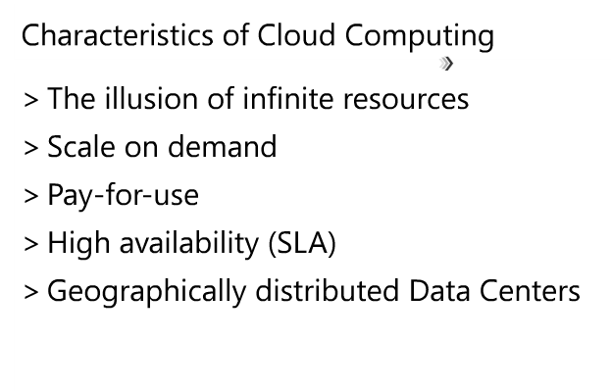

Slide 24
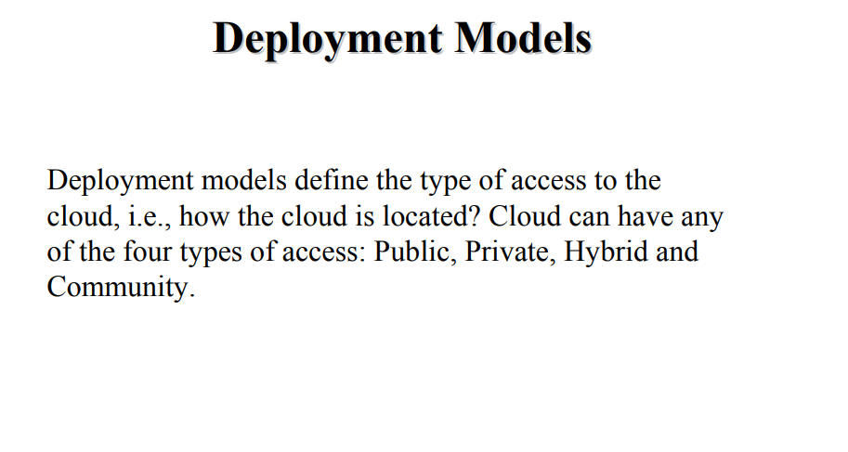

Slide 25
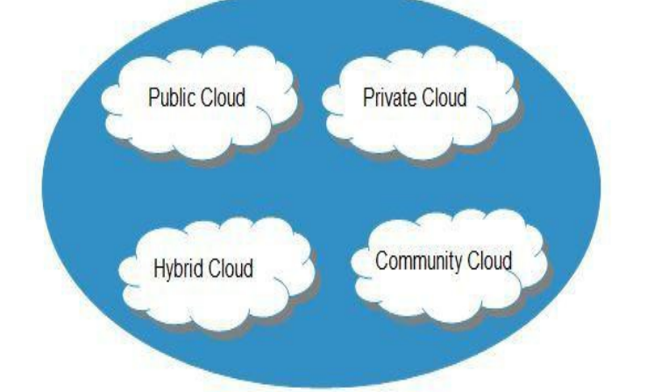

Slide 26
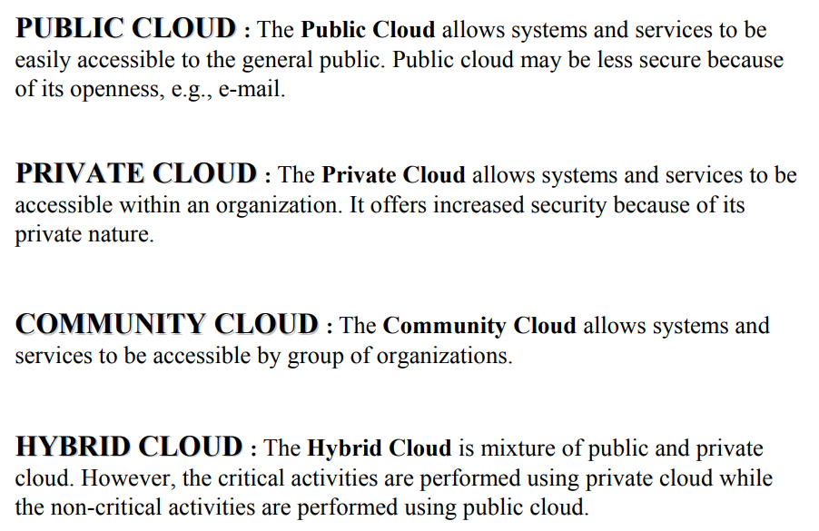

Slide 27
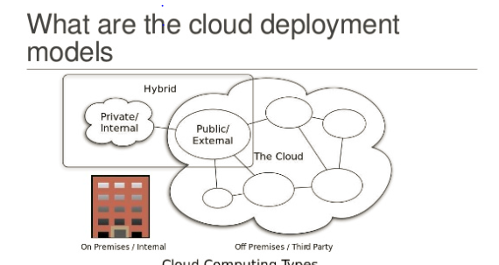

Slide 28
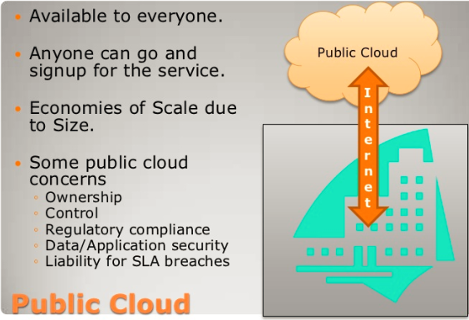
Cloud deployment models

Slide 29
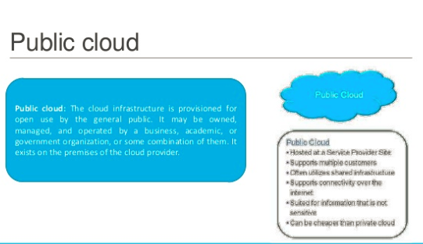

Slide 30
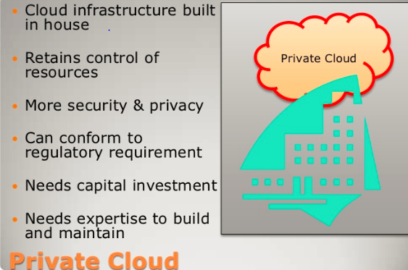

Slide 31
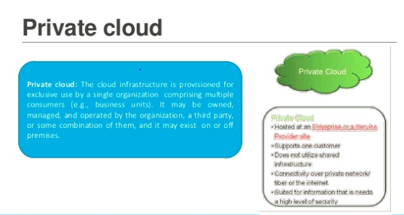

Slide 32
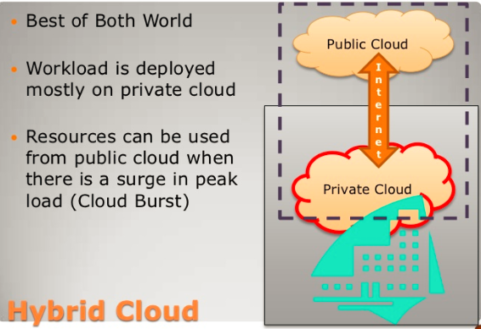

Slide 33
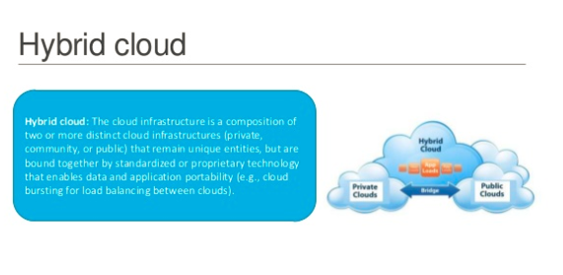

Slide 34
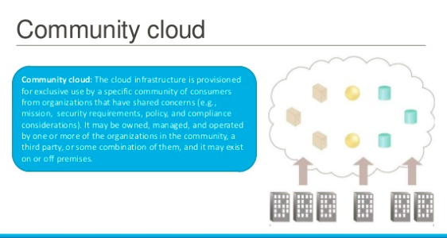

Slide 35
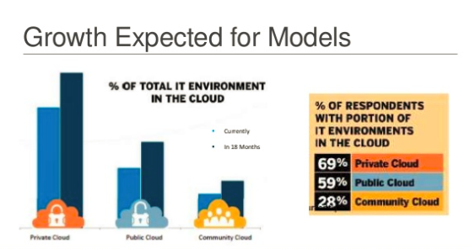

Slide 36
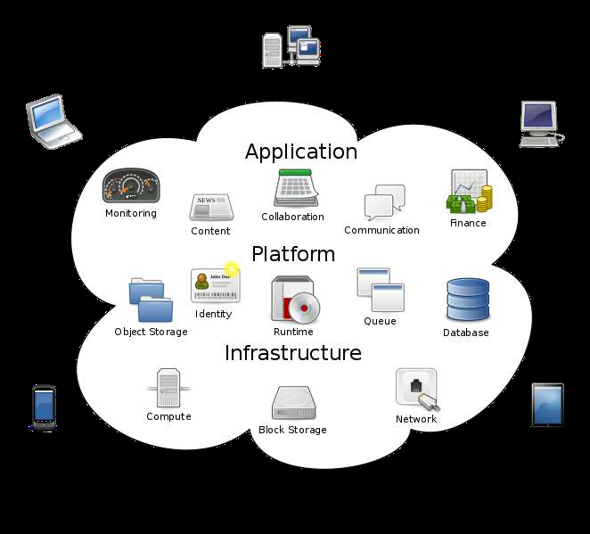

Slide 37
Module 2

Slide 38








The world is getting smarter
Smart traffic systems
Intelligent oil field technologies
Smart healthcare
Smart energy grids
Smart water management
Smart weather
Smart cities
Smart food systems

Slide 39
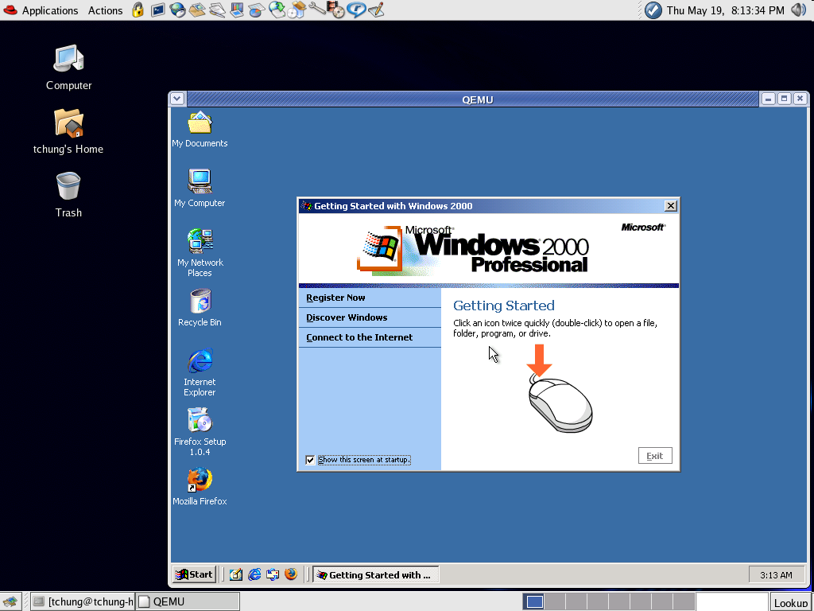
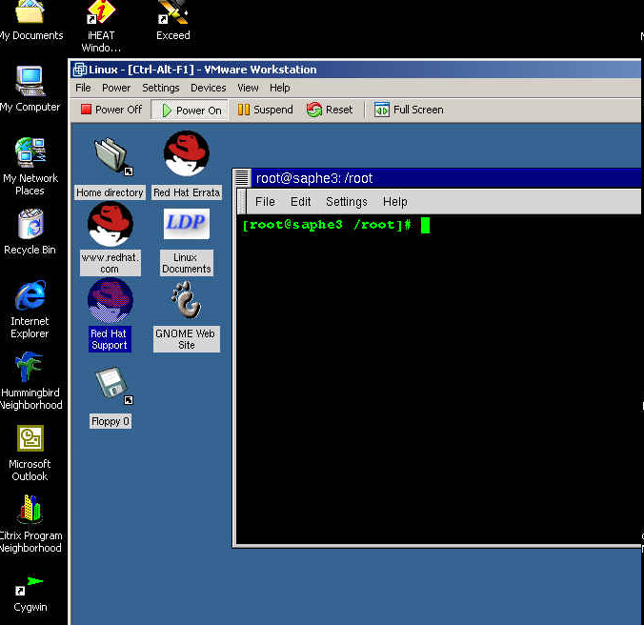
Introduction -Virtualization
Virtualization is way to run multiple operating systems and user applications on the same hardware
E.g., run both Windows and Linux on the same laptop
How is it different from dual-boot?
Both OSes run simultaneously
The OSes are completely isolated from each other

Slide 40
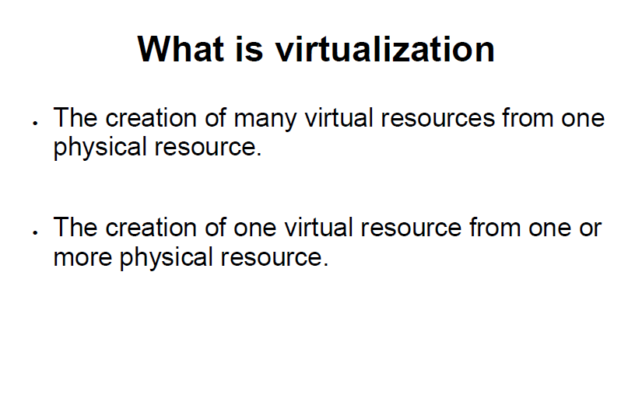

Slide 41
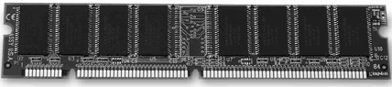
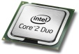
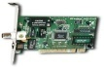
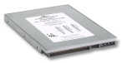
What is virtualization?
Virtualization is a broad term (virtual memory, storage, network, etc)
Focus for this course: platform virtualization
Virtualization basically allows one computer to do the job of multiple computers, by sharing the resources of a single hardware across multiple environments
Virtual
Container
Virtual
Container
App. A
App. B
App. C
App. D
App. A
App. B
App. C
App. D
Operating System
Virtualization Layer
Hardware
Hardware
‘Nonvirtualized’ system
A single OS controls all hardware platform resources
Virtualized system
It makes it possible to run multiple Virtual Containers on a single physical platform
Notes:
In computing, virtualization is a broad term that refers to the abstraction of computer resources:
Platform virtualization, which separates an operating system from the underlying platform resources
Full virtualization
Hardware-assisted virtualization
Paravirtualization
Operating system-level virtualization
Resource virtualization, the virtualization of specific system resources, such as storage volumes, name spaces, and network resources
Virtual memory, which allows uniform, contiguous addressing of physically separate and non-contiguous memory and disk areas
Redundant array of independent disks and logical volume management, combine many disks into one large logical disk.
Storage Virtualization, the process of completely abstracting logical storage from physical storage
Channel bonding, the use multiple links combined to work as though they offered a single, higher-bandwidth link
Network virtualization, creation of a virtualized network addressing space within or across network subnets
Computer clusters and grid computing, the combination of multiple discrete computers into larger metacomputers
Application Virtualization, the hosting of individual applications on alien hardware/software
Portable application
Cross-platform virtualization
Emulation or simulation
Virtualization Development, further work in this area
Desktop virtualization, the remote manipulation of a computer desktop
In the past
One operating systems in one machine, so the OS had completely control of the resources in that machine.
Virtualization Era
Virtualization is a software layer in between the machine and the operating system. Essentially what this software layer does is to divide the resources of the machine among all the guest operating systems. The Virtualization Layer is in charge of multiplexing the hardware resources to several operating systems. Each OS has the illusion that it controls the complete hardware but, in fact, the machine can now host a number of operating systems because the virtualization layer makes all the switching behind scenes.
Supporting multiple instances of Operating Systems: Homogeneous or Heterogeneous
One physical machine can host several Linux/Window copies

Slide 42
Computing Infrastructure – 2000
Evolution of Virtualization
1 machine → 1 OS → several applications
Applications can affect each other
Big disadvantage: machine utilization is very low, most of the times it is below than 25%
App
App
App
App
App
App
App
App
X86
Windows
XP
X86
Windows
2003
X86
Suse
X86
Red Hat
12% Hardware
Utilization
15% Hardware
Utilization
18% Hardware
Utilization
10% Hardware
Utilization
Notes:
x86 architecture
The generic term x86 refers to the "CISC" type instruction set of the most commercially successful CPU architecture in the history of personal computing, used in processors from Intel®, AMD, VIA, and others. It derived from the model numbers of the first few generations of CPUs, backward compatible with Intel®'s original 16-bit 8086 of 1978, most of which were ending in "86".
As the x86 term became common after the introduction of the 80386 in 1985, it usually implies a binary compatibility also with the extended 32-bit instruction set of the 80386. This may sometimes be emphasized as x86-32 to distinguish it either from the original 16-bit x86-16 or from the newer 64-bit x86-64 (also called x64).
Today, x86 hardware usually implies also 64-bit capabilities, at least for personal computers and servers. However, to avoid compatibility problems, x86 software usually implies only 32-bit, while x86-64 or x64 are used to denote exclusive 64-bit software.
The only significant competitors to x86 in PCs were the Motorola 68k, CISC type, and the PowerPC, RISC type, instruction sets. However, by August 7, 2006, Apple Inc. switched to x86 CPUs granting the x86 instruction set an effective monopoly among desktop and notebook processors. The x86 also held a growing majority among servers and workstations. Markets without a significant x86 presence include low cost embedded processors found in appliances and toys, among others.
Countless computer software is written for the x86 platform – including nearly all modern commercial operating systems from MS-DOS and Microsoft Windows to Linux, BSD, Solaris OS, and Mac OS X – making the x86 instruction set architecture indispensable on a global scale, and practically irreplaceable.
It was cheaper, safer and easier to buy a whole new hardware for a new customer with new service requirements than to install the applications on the same HW.

Slide 43
Virtualization again…
Evolution of Virtualization
x86 server deployments introduced new IT challenges:
Low server infrastructure utilization (10-18%)
Increasing physical infrastructure costs (facilities, power, cooling, etc)
Increasing IT management costs (configuration, deployment, updates, etc)
Insufficient failover and disaster protection
The solution for all these problems was to virtualize x86 platforms
Notes:
The logical solution was to implement virtualization in the x86 market to make use of all the investment already done in the new cheaper infrastructure.

Slide 44
Computing Infrastructure - Virtualization
Evolution of Virtualization
It matches the benefits of high hardware utilization with running several operating systems (applications) in separated virtualized environments
Each application runs in its own operating system
Each operating system does not know it is sharing the underlying hardware with others
App. A
App. B
App. C
App. D
X86
Windows
XP
X86
Windows
2003
X86
Suse
Linux
X86
Red Hat
Linux
X86 Multi-Core, Multi Processor
70% Hardware Utilization
Notes:
Hardware Utilization
Financial influences: More utilization so less hardware so less cooling so less electricity

Slide 45
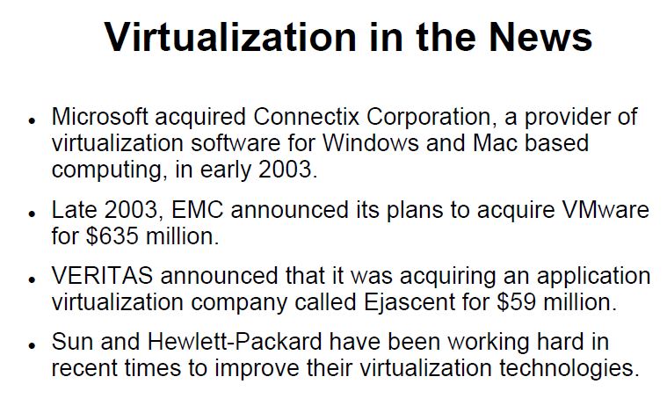

Slide 46
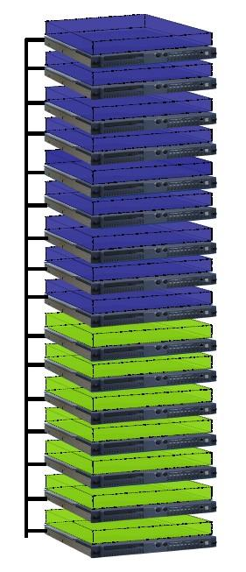
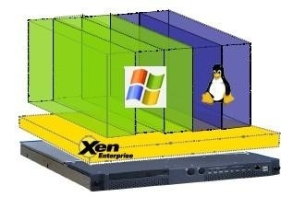
Hardware vs Virtualization

Slide 47
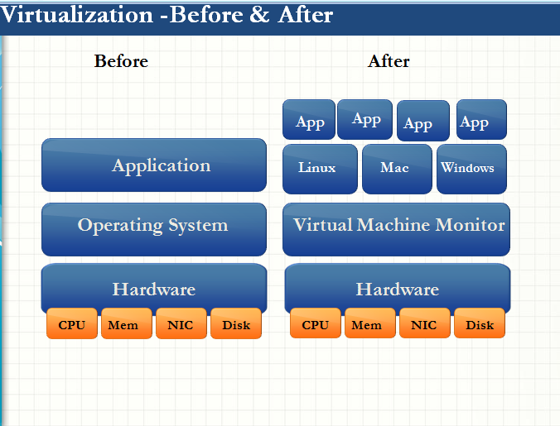

Slide 48
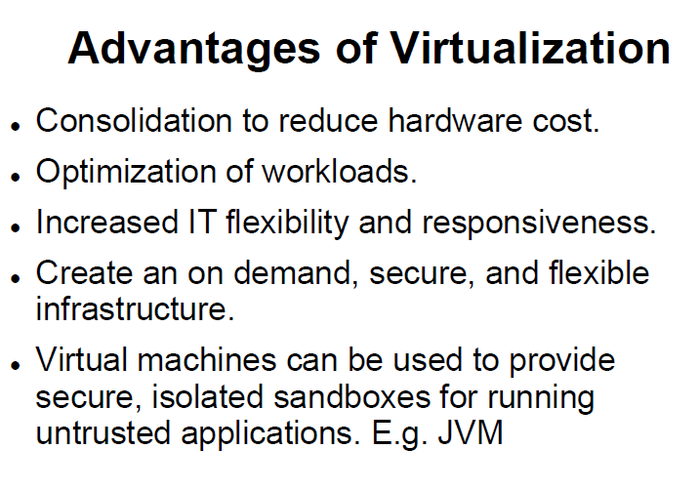

Slide 49
Need for virtualization
Fully utilize hardware resources
Running heterogeneous and conflicting environments
Isolation
Manageability
Reduced Power requirements
Reduced ownership cost
Server consolidation
Run a web server and a mail server on the same physical server
Easier development
Develop critical operating system components (file system, disk driver) without affecting computer stability

Slide 50
Hypervisor
In computing, a hypervisor (also: virtual machine monitor) is a virtualization platform that allows multiple operating systems to run on a host computer at the same time. The term usua-lly refers to an implementation using full virtualization.

Slide 51
Two types of hypervisors
Definitions
Hypervisor (or VMM – Virtual Machine Monitor) is a software layer that allows several virtual machines to run on a physical machine
The physical OS and hardware are called the Host
The virtual machine OS and applications are called the Guest
Type 1 (bare-metal)
Type 2 (hosted)
VM1
VM2
Guest
Guest
VM1
VM2
Process
Hypervisor
Hypervisor
OS
Host
Host
Hardware
Hardware
VMware ESX, Microsoft Hyper-V, Xen
VMware Workstation, Microsoft Virtual PC, Sun VirtualBox, QEMU, KVM

Slide 52
Hypervisor
Hypervisors are currently classified in two types:
Type 1 hypervisor (or Type 1 virtual machine monitor) is software that runs directly on a given hardware platform (as an operating system control program). A "guest" operating system thus runs at the second level above the hardware.
The classic type 1 hypervisor was CP/CMS, developed at IBM in the 1960s, ancestor of IBM's current z/VM. More recent examples are Xen, VMware's ESX Server, and Sun's Hypervisor (released in 2005).
Type 2 hypervisor (or Type 2 virtual machine monitor) is software that runs within an operating system environment. A "guest" operating system thus runs at the third level above the hardware.
Examples include VMware server and Microsoft Virtual Server.

Slide 53
Bare-metal or hosted?
Bare-metal
Has complete control over hardware
Doesn’t have to “fight” an OS
Hosted
Avoid code duplication: need not code a process scheduler, memory management system – the OS already does that
Can run native processes alongside VMs
Familiar environment – how much CPU and memory does a VM take?
A combination Mostly hosted, but some parts are inside the OS kernel for performance reasons

Slide 54
Limitations
Limitations
Not all applications are specifically designed to be virtualization-friendly.
This means that some aspects of your computer technology within your business might not leave you with the available option of virtualization.
Instant Access to Data
Since data is essential to your business it is essential that you only choose virtualization options that offer adequate data protection.
Not owning your own servers can put your data at risk and this is not ideal. You do not want your data to be vulnerable.

Slide 55
FOUR MAJOR HYPERVISORS
We compare four major hypervisors – KVM, Xen, VMware and Hyper-V.
KVM – a Linux based open source hypervisor. First introduced into the Linux kernel in February 2007, it is now a mature hypervisor and is probably the most widely deployed open source hypervisor in an open source environment. KVM is used in products such as Redhat Enterprise Virtualization (RHEV).
Xen – An open source hypervisor which originated in a 2003 Cambridge University research project. It runs on Linux (though being a Type 1 hypervisor, more properly one might say that its dom0 host runs on Linux, which in turn runs on Xen). It was originally supported by XenSource Inc, which was acquired by Citrix Inc in 2007.
VMware – is not a hypervisor, but the name of a company, VMware Inc. Our experience with VMware involves its vSphere product. vSphere uses VMware’s ESXi hypervisor. VMware’s hypervisor is very mature and extremely stable.
Hyper-V – Hyper-V is a commercial hypervisor provided by Microsoft. Whilst excellent for running Windows, being a hypervisor it will run any operating system supported by the hardware platform.

Slide 56
Challenges
Assuring Compatibility and Efficiency
When it comes to Virtualization, one of the biggest obstacles that needs to be overcome is preparing a robust infrastructure and making sure that all its underlying components such as CPU, Storage Devices, Operating Systems, Network etc. are compatible, efficient and will provide sufficient performance without affecting the workflow.
Making sure that all these are in place may take a lot of time and may require special skills. It also depends on how modern your equipment is.
If you do not have the skills readily available in-house, you may need to acquire these or engage a consultant beforehand and establish a preset list of mandatory changes and improvements in order to assure a smooth virtualization process.

Slide 57
The Network
Virtualizing servers before making sure that the network infrastructure can handle it is a risky undertaking.
After the process is complete the network will be under a lot more strain and making sure that it has what it takes to sustain the added traffic is critical.
Once the virtualization process is complete and problems arise, it will be very difficult to tell whether the performance issues are linked to network issues or at the server end.

Slide 58
Computational and storage capacity
Besides obvious differences, virtual machines also generate I/O requests at an increased frequency and since virtualization means creating more servers, discs may have trouble keeping up with the increased workload.
It is not uncommon to realize that some applications are actually slower when run through virtualized machines even if memory management techniques like page sharing are in place and being used.
This is because larger blocks of data have increased priority which means that smaller I/O requests have to wait before being processed.
A viable solution for this kind of issues is workload analysis before the virtualization so that you are able to estimate approximate future hardware and network usage and prepare accordingly.

Slide 59
Pitfalls
Mismatching Servers
This aspect is commonly overlooked especially by smaller companies that don't invest sufficient funds in their IT infrastructure and prefer to build it from several bits and pieces.
This usually leads to simultaneous virtualization of servers that come with different chip technology (AMD and Intel).
Frequently, migration of virtual machines between them won't be possible and server restarts will be the only solution.
This is a major hindrance and actually means losing the benefits of live migration and virtualization.

Slide 60
Creating Too many Virtual Machines per Server
One of the great things about virtual machines is that they can be easily created and migrated from server to server according to needs.
However, this can also create problems sometimes because IT staff members may get carried away and deploy more Virtual Machines than a server can handle.
This will actually lead to a loss of performance that can be quite difficult to spot.
A practical way to work around this is to have some policies in place regarding VM limitations and to make sure that the employees adhere to them.

Slide 61
Misplacing Applications
A virtualized infrastructure is a more complex than a traditional one and with a number of applications deployed, losing track of applications is a distinct possibility.
Within a physical server infrastructure keeping track of all the apps and the machines running them isn’t a difficult task.
However, once you add a significant number of virtual machines to the equation, things can get messy and App patching, software licensing and updating can turn into painfully long processes.

Slide 62
Features of VM
CLONE:
A clone is a copy of an existing virtual machine.
The existing virtual machine is called the parent of the clone.
Installing a guest operating system and applications can be time consuming.
With clones, you can make many copies of a virtual machine from a single installation and configuration process.
Clones are useful when you must deploy many identical virtual machines to a group.

Slide 63
Features of VM
CLONE:
Clone is exact copy of your existing VM but it gives you option to change the name of your destination VM as well as the resources.
When you clone a virtual machine, you create a copy of the entire virtual machine, including its settings, any configured virtual devices, installed software, and other contents of the virtual machine's disks.
You also have the option to use guest operating system customization to change some of the properties of the clone, such as the computer name and networking settings.

Slide 64
Snapshots
Snapshot is an instance in time of a VM to preserve its state, snapshots are usually used for testing/development purposes as it allows you to revert back to previous state of VM.
Snapshots create additional vmdk files as consumes disk space hence take snapshots with care and always delete the snapshots after completing your testings.

Slide 65
Template
Is a master copy of a virtual machine that can be used to create and provision virtual machines.
Templates cannot be powered on or edited, and are more difficult to alter than ordinary virtual machine.
A template offers a more secure way of preserving a virtual machine configuration that you want to deploy many times.
VM Templates >A copy of pre-installed VMs containing all the software and configuration settings that would make the VM work when deployed

Slide 66
Template
Templates are pre-configured VMs used for multiple deployments say you have to deploy W2K8 R2 Server 20 times in this case best would be to create a master copy of W2K8 R2 with all basic setups and create a template of it.
Thereafter use this template to deploy your 20 VMs.
The configuration file of a template VM will be *.vmtx and not *.vmx that way you can identify the VM in your data store as template VM.
The template typically includes a specified operating system and a configuration that provides virtual counterparts to hardware components. Optionally, a template can include an installed guest operating system and a set of applications.

Slide 67
Import and export
.ovf
.ova

Slide 68
What is the use of privileged instruction
A class of instructions, usually including storage protection setting, interrupt handling, timer control, input/output, and special processorstatus-setting instructions, that can be executed only when the computer is in a special privileged mode that is generally available to an operating or executive system, but not to user programs.
A machine code instruction that may only be executed when the processor is running in supervisor mode.
Privileged instructions include operations such as I/O and memory management.
A trap is an exception in a user process. It's caused by division by zero or invalid memory access. It's also the usual way to invoke a kernel routine (a system call) because those run with a higher priority than user code.

Slide 69
FULL VIRTUALIZATION (What is ?) •
It is a virtualization technique used to provide a virtual machine environment which is a complete simulation of the underlying hardware.
• All operating systems and applications which can run natively on the hardware can also be run in the virtual machine.
• The guest OS need not be modified.
• Guest OS do not aware the existence of VM
. • Each VM is independent of each other.

Slide 70
Types of Full Virtualization
➢Hypervisor or Virtual Machine Monitor (VMM)
✓ SW component that implements virtual machine hardware abstraction.
✓ Responsible for hosting and managing virtual machines & running of guest OS.
H O S T E D
B A R E M E T A L

Slide 71
virtualization – Challenges (X86)
➢ CPU provide 4 protection level( Ring 0 to Ring 3) to OS to execute code.
➢ OS kernel is designed to run at ring 0 to execute the code directly on the hardware and handle privileged instruction .
➢ User Application(s) run at ring 3 (less privileged)
So Where Hypervisor resides?

Slide 72
Para Virtulization
Paravirtualization refers to communication between the guest OS and the hypervisor to improve performance and efficiency.
Paravirtualization, involves modifying the OS kernel to replace non -virtualizable instructions with hypercalls that communicate directly with the virtualization layer hypervisor. (Virtualized Resources and Non-Virtualized Resources).
The hypervisor also provides hypercall interfaces for other critical kernel operations such as memory management, interrupt handling and time keeping.

Slide 73
Full vs Para Virtulization
Paravirtualization is different from full virtualization, where the unmodified OS does not know it is virtualized and sensitive OS calls are trapped using binary translation.
Performance advantage of paravirtualization over full virtualization can vary greatly depending on the workload.
As paravirtualization cannot support unmodified operating systems (e.g. Windows 2000/XP), its compatibility and portability is poor.
Paravirtualization can also introduce significant support and maintainability issues in production environments as it requires deep OS kernel modifications.
The open source Xen project is an example of paravirtualization that virtualizes the processor and memory using a modified Linux kernel and virtualizes the I/O using custom guest OS device drivers

Slide 74
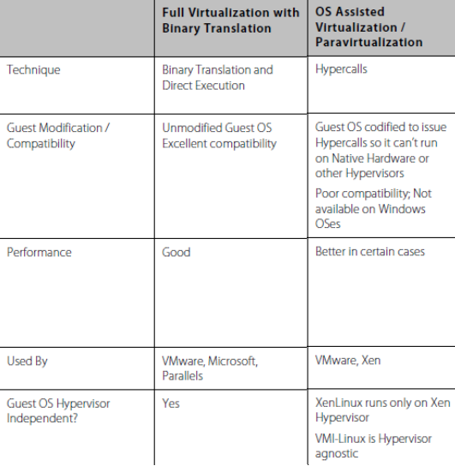

Slide 75
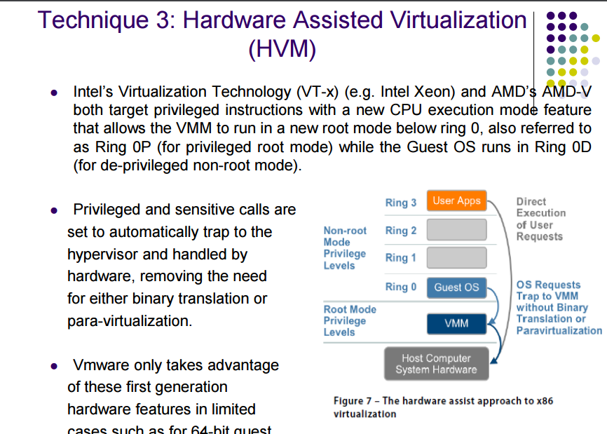

Slide 76
Types of Clone: Full and Linked
There are two types of clone:
The Full Clone — A full clone is an independent copy of a virtual machine that shares nothing with the parent virtual machine after the cloning operation. Ongoing operation of a full clone is entirely separate from the parent virtual machine.
The Linked Clone — A linked clone is a copy of a virtual machine that shares virtual disks with the parent virtual machine in an ongoing manner. This conserves disk space, and allows multiple virtual machines to use the same software installation.

Slide 77
Difference Between Full Clone and Linked Clone
The Full Clone :
A full clone is an independent virtual machine, with no need to access the parent.
A linked clone must have continued access to the parent. Without access to the parent, a linked clone is disabled. See Linked Clone and Access to the Parent Virtual Machine.
The Linked Clone
A linked clone is made from a snapshot of the parent.
In brief, all files available on the parent at the moment of the snapshot continue to remain available to the linked clone.
Ongoing changes to the virtual disk of the parent do not affect the linked clone, and changes to the disk of the linked clone do not affect the parent.

Slide 78
Benefits of Full Clones
Full clones do not require an ongoing connection to the parent virtual machine.
Overall performance of a full clone is the same as a never-cloned virtual machine, while a linked clone trades potential performance degradation for a guaranteed conservation of disk space.
If you are focused on performance, you should prefer a full clone over a linked clone.

Slide 79
Benefits of Linked Clones
Linked clones are created swiftly. A full clone can take several minutes if the files involved are large.
A linked clone lowers the barriers to creating new virtual machines, so you might swiftly and easily create a unique virtual machine for each task you have.
Another benefit of linked clones is that they are easier to share.
If a group of people needs to access the same virtual disks, then the people can easily pass around clones with references to those virtual disks.
For example, a support team can reproduce a bug in a linked clone and then just email that linked clone to development. This is feasible only when a virtual machine isn't gigabytes in size.

Slide 80
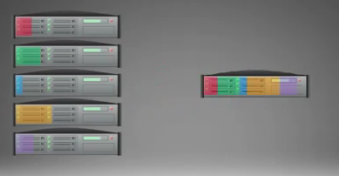
Server Virtualization
“Server virtualization in general terms lets you take a single physical device and install (and run simultaneously) two or more OS environments that are potentially different and have different identities, application stacks, and so on.”

Slide 81
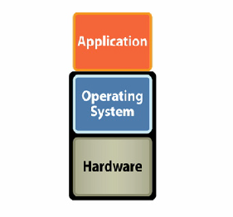
Typical Server Model

Slide 82
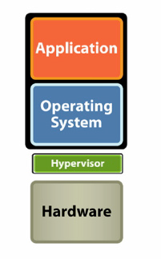
Virtualized Server Model

Slide 83
VMware By the Numbers
Founded
1998
2006 Revenue
$709 M
Number of Employees
2,500+
Number of VMware Infrastructure Customers
20,000+
Number of Users
4+ million
Number of Channel Partners
3,000+
Number of VMware Certified Professionals
10,000+
Notes:
VMware was founded in 1998 to bring the concept of virtualization to industry standard x86 systems. The concept of virtualization had been known since the 60ies mainframe world but for a long time n o one was able to “crack the code” for bringing this concept to x86 systems.
Since then VMware has grown to almost a $1 billion run rate company – we closed 2006 with revenue of $708 m, and in Q4 06 alone we did $232 in revenue. This tremendous revenue growth underscores the market acceptance of virtual infrastructure as one of the few technologies that delivers immediate value to customers.
What is even more exciting than the revenue growth is that more than 20K customers are using the virtual infrastructure suite to transform their IT environment. On the desktop side, VMware’s product have more than 4 million users.
Since pioneering virtualization for x86 systems 9 years ago, a large and vibrant ecosystem has developed around VMware. Today, more than 3K partner resell VMware products and provide solutions based on VMware products. There are more than 10K VMware Certified Professionals (VCPs).

Slide 84






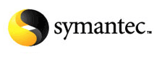









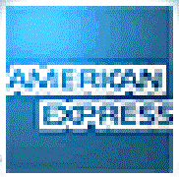

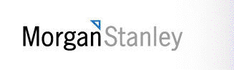
Who Uses VMware?
100% of the Fortune 100
Notes:
ESX Server has enjoyed tremendous success among the worlds largest businesses as they’ve adopted virtual infrastructure to improve operations in their datacenters. VMware servers are in use by over 10,000 enterprises, some of whom are shown here.

Slide 85
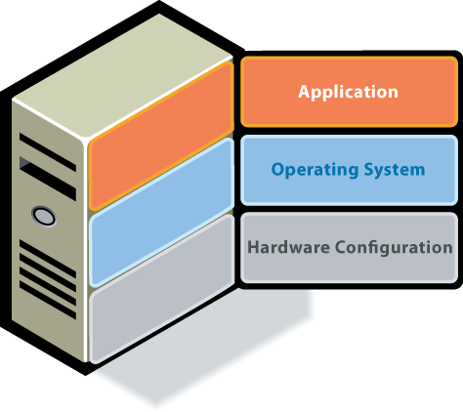
Virtualization Technology Overview
The Challenge
Old Model: Traditional x86 Architecture
Single OS image per machine
Software and hardware tightly coupled
Multiple applications often conflict
Underutilized resources
→ Old model is challenging!
Notes:
In the traditional IT stack there was a rigid 1-1 mapping between hardware, an instance of an operating system and a single software application. That rigid model lead to tremendous under-utilization of hardware resources. The industry statistic is that in this traditional model, servers are utilized only 5-15%. This is a huge problem for companies – having a very large pool of resources that stays idle most of the time. it is a picture that CFOs are very unhappy about.
But the story doesn't end there – the server sprawl and the associated underutilization of resources have ripple through effects for the entire environment – server sprawl means not only wasted investment in hardware, but also unsustainable power, cooling, and real estate costs. This tremendous complexity means that it is hard to provision new infrastructure and to respond to changing business needs. IT departments are stuck wasting cycles on mundane tasks, and don’t have time to focus on what really matters. For example, in most companies a single sys admin can support only up to 20 servers, and the time for provisioning a new server is often 6-8 weeks.

Slide 86


State of Infrastructure Today – Physical
Server Sprawl
Power & Cooling
38 m physical servers by 2010 - 700% increase in 15 years
$140 bn in excess server capacity - a 3-year supply
50c for every $1 spent on servers
$29 bn in power and cooling industry wide
Space Crunch
Operating Cost
$8 in maintenance for every $1 spent on new infrastructure
20-30 : 1 server-to-admin ratio
$1,000 /sqft
$2,400 / server
$40,000 / rack
Source: IDC
Notes:
Before we highlight what customers have been able to do with virtualization, let’s put some more color around the magnitude of the problem we are solving.
Server sprawl – read the stats
Power & cooling – read the stats
Space crunch – read the stats
Operating / labor cost – read the stats.
SOURCE: IDC

Slide 87
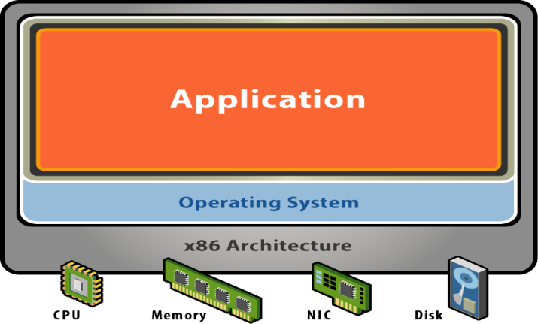
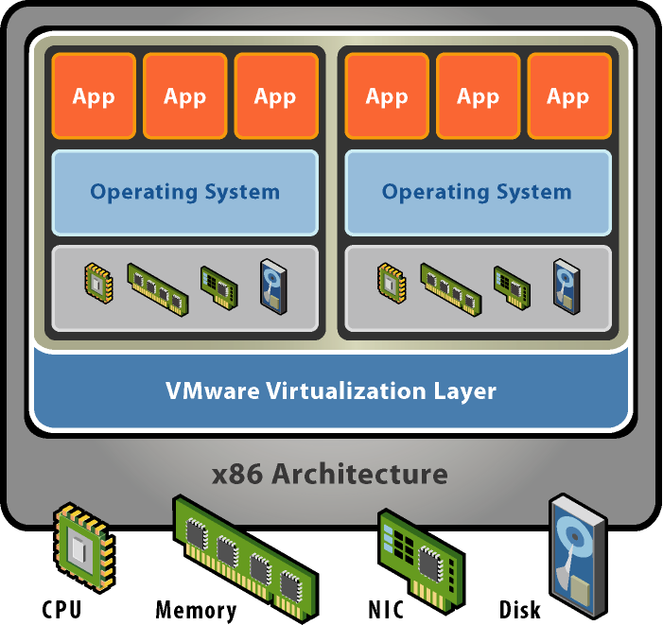
What is Virtualization?
Without Virtualization
With Virtualization
Application
Operating System
Hardware
VMware provides hardware virtualization that presents a complete x86 platform to the virtual machine
Allows multiple applications to run in isolation within virtual machines on the same physical machine
Virtualization provides direct access to the hardware resources to give you much greater performance than software emulation
Notes:
Virtual machines are not a new concept. They were developed over thirty years ago for mainframe systems to allow multiple users to safely share those expensive machines. As computers became cheaper, the motivation behind virtualization faded and processor architectures like the Intel x86 were developed without some of the features needed to support virtualization.
VMware’s founders resurrected the virtual machine concept when problems like server proliferation and the need to run multiple applications in dedicated operating systems started becoming serious issues for IT managers and software developers. VMware developed revolutionary technology to efficiently virtualize x86 systems that,for the first time, allowed unmodified x86 operating systems and applications to run in true virtual machines with excellent performance.
Multiple virtual machines can operate concurrently on a single x86 host system. Each one can run a different operating system and application stack.
VMware’s virtualization technology provides each virtual machine with a true representation of an x86 computer, complete with processor, memory, networking interfaces and storage devices. The VMware virtualization layer gives the virtual machines direct access to the underlying x86 hardware – an important distinction from the much slower emulation technology that must process all virtual machine operations in software.

Slide 88


Virtualization Increases Hardware Utilization
Before VMware
After VMware
Virtualization enables consolidation of workloads from underutilized servers onto a single server to safely achieve higher utilization
Notes:
One of the clearest benefits ESX Server users see after consolidating servers into virtual machines is a huge improvement in server utilization as measured by average CPU usage. IT administrators generally dedicate a single x86 server per application because of issues like application compatibility problems when running on a single OS image, software vendor requirements or internal billing constraints. The result of that “one application, one server” practice is a datacenter filled to capacity with servers running at 5-15% utilization.
With multiple servers consolidated on an ESX Server host, customers are able to reliably operate their servers at 60-80% CPU utilization – a huge improvement in the return on investment in their server hardware. This higher CPU utilization is possible only with the intelligent CPU resource controls made possible by the bare-metal architecture of ESX Server. Normally, running a server at high CPU utilization creates the risk of a critical service being starved for CPU if others experience a load peak. ESX Server eliminates that risk with its CPU resource controls that assign CPU capacity to virtual machines on a “fair share” basis and it also allows an absolute minimum level of CPU capacity to be allocated to critical virtual machines. CPU allocations can also be dynamically adjusted so you can “dial in” more capacity for a virtual machine in anticipation of a period of high load. ESX Server will enforce admission controls to prevent additional virtual machines from being started on a host if minimum resource guarantees for existing virtual machines could not be assured.
Running your servers at higher utilization really changes datacenter economics. Now it becomes justifiable to invest in higher end server features like redundant power supplies, hot swappable components, dual storage adapters and teamed NICs when you can divide the cost of those features across multiple servers running in virtual machines rather than across just one application running on a single OS image. That’s important if you’re worried about putting all your eggs in one basket with virtual machine server consolidation – you can now afford more reliable servers and also feel confident in the rock-solid proven reliability of the ESX Server platform.

Slide 89

Key Properties of Virtual Machines
Partitioning
Run multiple operating systems on one physical machine
Divide system resources between virtual machines
Notes:
The hypervisor (ESX Server and ESX Server 3i) then partitions a server into multiple virtual machines. VMs are basically just files and can be treated like files. This gives VMs amazing properties that then enable a much broader set of capabilities beyond just running many VMs on one server, not possible in the physical world. These properties:
Partitioning: With ESX Server you are able to run many different OS-es on the same machine
Isolation: These VMs running on a physical machine are independent and unaware of each other. Infecting one doesn’t mean affecting all the others.
Encapsulation: Since the entire OS + app is packaged up into a set of files – manipulation of VMs becomes very much simpler than their physical counterparts
Hardware independence: Virtual machines can be created on any x86 hardware and moved to any other x86 hardware; in many cases live

Slide 90


Key Properties of Virtual Machines
Partitioning
Run multiple operating systems on one physical machine
Divide system resources between virtual machines
Isolation
Fault and security isolation at the hardware level
Advanced resource controls preserve performance

Slide 91


Key Properties of Virtual Machines
Partitioning
Run multiple operating systems on one physical machine
Divide system resources between virtual machines
Isolation
Fault and security isolation at the hardware level
Advanced resource controls preserve performance
Encapsulation
Entire state of the virtual machine can be saved to files
Move and copy virtual machines as easily as moving and copying files

Slide 92

Key Properties of Virtual Machines
Partitioning
Run multiple operating systems on one physical machine
Divide system resources between virtual machines
Isolation
Fault and security isolation at the hardware level
Advanced resource controls preserve performance
Encapsulation
Entire state of the virtual machine can be saved to files
Move and copy virtual machines as easily as moving and copying files
Hardware-Independence
Provision or migrate any virtual machine to any similar or different physical server

Slide 93



State of Infrastructure with Virtualization
BEFORE VMware
AFTER VMware
SAVINGS
Servers | 1000 | 80 | $5,816 (per server removed)
HBAs | 500 | 160 | $290
SAN Switches | 22 | 8 | na
Network Switches | 84 | 10 | $296
Power (kWh) | 407 | 52 | $759
Cooling (kWh) | 509 | 64 | $949
Real Estate (Sq ft) | 2053 | 257 | $431(3yr)
Total Savings (Over 3 years) |  |  | $8,541* (per server)
* Note: Savings include estimated cost of VMware licenses, Support and Subscription
Notes:
This is an example of a customer that embarked on a large scale server consolidation project. They started with 1000 servers, and after consolidation, ended up with 80 virtualized servers. The hardware cost savings from doing that were close to $6000 per server removed from the datacenter.
Once they removed so many servers from the datacenter, the environmental costs went down as well. For every application they started running in a VM, they saved close to $1700 in power and cooling and $400+ in real estate on 3 yr basis. And it is important to emphasize that these savings are ongoing, not one-off like the hardware savings.
Overall, the company saved more than $8K in 3 yrs for every application that they started running in a VM.

Slide 94







The Enterprise PC Challenge
IT: Are We Having Fun Yet?
Notes:
IT is facing many challenges dealing with the wide variety of PCs and devices in their organization.

Slide 95

ESX Server
Deploy multiple virtual machines on a single physical server
Market leading:
Virtual Machines
ESX Server
Performance
Stability
Scalability
Cross-platform support
Physical Server
Notes:
VMware’s hypervisor for the data center is called “ESX Server” First launched in 2001, we are now on the third generation at ESX 3, serving over 20,000 enterprise customers.
ESX Server is a bare metal virtualization platform, that is, it sits on top of the server hardware directly and allows partitioning of the underlying CPU, memory, network and storage resources between virtual machines that sit on top of it.
This hypervisor layer is an important choice to make especially because when you consolidate several servers onto a single one with many virtual machines, the hypervisor layer needs to be sturdy and reliable.
What are some of the key things to look for in a hypervisor?
<CLICK>
Performance: Bare metal hypervisor architecture near native performance. ESX Server allows consolidation ratios of 10:1, 20:1 and sometimes as high as 30:1. Customers report that most people don’t even realize they are running virtualized. This is a testament to how solid the performance of the hypervisor is.
Stability: >3 years of uptime at a customer, 86% of customers use in production, 43% standardize on VMs
Scalability: The hypervisor needs to scale to meet workload requirements – ESX Server supports 4 way VSMP(running VMs with as many as 4 CPUs assigned to them), 64GB RAM, support for 64-bit Guest operating systems and supports servers with upto 128 GB of physical memory.
Cross-platform support: HW agnostic, widest guest OS support including windows (multi-generations), linux, solaris x86, novell

Slide 96



Non-Disruptive Capacity on Demand
Notes:
Believe it or not
Potential problems are diagnosed as soon as they start occurring and preventive medicine is administered. i.e. as soon as an application starts experiencing increased load, and is consequently starved for resources, and before it has hit serious performance issues, DRS detects that event, and provides more resources to that virtual machine. This is the self-adjusting, self optimizing datacenter. Normally sys admins would learn about such problems when their phones start ringing off the hook because a major application is down.
You can allocate your available resources depending on the value of the applications they support. Not all applications are created equal – some are more important than the others. With DRS you can ensure that the important applications always take precedence if there is competition for resources.
VMware® Distributed Resource Scheduler (DRS) dynamically allocates and balances computing capacity across a collection of hardware resources aggregated into logical resource pools. VMware DRS continuously monitors utilization across resource pools and intelligently allocates available resources among the virtual machines based on pre-defined rules that reflect business needs and changing priorities. When a virtual machine experiences an increased load, VMware DRS automatically allocates additional resources by redistributing virtual machines among the physical servers within the network. VMware DRS allows IT organizations to:
Prioritize resources to the highest value applications in order to align resources with business goals.
Optimize hardware utilization automatically and continuously to respond to changing conditions.
Provide dedicated (virtual) infrastructure to business units while giving central IT complete control over hardware.
Conduct zero-downtime server maintenance
How does VMware DRS work?
VMware DRS dynamically allocates and balances computing capacity across collections of hardware resources aggregated into logical resource pools. VMware DRS continuously monitors utilization across the resource pools and intelligently allocates available resources among virtual machines.
VMware DRS allows users to define the rules and policies how virtual machines share resources and how these resources are prioritized among multiple virtual machines. When a virtual machine experiences increased load, VMware DRS first evaluates its priority against the established resource allocation rules and policies, and if justified, allocates additional resource. .Additional resources are allocated to the virtual machine by either migrating it to another server with more available resources or by making more “space” for it on the same server by migrating other virtual machines to different servers..
VMware DRS can be configured to operate in automatic or manual mode. In automatic mode, it migrates virtual machines to the most appropriate physical servers. The live migration of the virtual machines to the different physical server is executed completely transparent to end-users though VMware VMotion. In manual mode, VMware DRS provides a recommendation for optimal placement of virtual machines, and leaves it to the system administrator to decide whether to make the change.
Flexible hierarchical organization of resource pools allows administrators to match available IT resources to the needs of the business organization. Individual business units can receive dedicated IT resources while still benefiting from the efficiency of resource pooling. Robust access privileges make it possible to delegate routine infrastructure tasks for a business unit resource pool to a business unit administrator.
VMware DRS optimizes IT environments to align resources with business goals while ensuring flexibility and efficient utilization of hardware resources.
How Is VMware DRS Used in the Enterprise?
Align IT resources with business priorities. Define rules and policies how resources are prioritized among virtual machines. VMware DRS dynamically and intelligently allocates IT resources to the highest priority virtual machines to ensure optimal alignment between business and IT.
Guarantee IT autonomy and service levels to business organizations. Provide dedicated IT infrastructure to business units while still profiting from higher hardware utilization through resource pooling.
Dramatically increase system administrator productivity. Enable a single system administrator to monitor and effectively manage a large pool of infrastructure resources.
Automate hardware maintenance. Place a physical server in maintenance mode and VMware DRS will automatically migrate all virtual machines to other physical servers, allowing server maintenance with zero downtime.

Slide 97
Instant Provisioning in a Virtualized Environment
Physical
Configure hardware
Install OS
Configure
OS & Tools
Assign IP Addr
Configure Network
Test Apps
20-40 hrs of work
4-6 week lead time
<1 hr of work
1-2 days lead time
Deploy from Template
Power
on VM
Virtual
Provisioning time reduced to minutes, not days to weeks!
Notes:
Now let’s take a very specific look comparing the provisioning activity in the virtual versus physical world.
In the physical world, you have to procure and configure the hardware. This is an activity that can takes weeks if you need to order a new system. Then you go through the process of configuring the OS, networking, and applications. All together, this could be 20-40 hours of actual work, plus 4-6 weeks of time from start to finish.
By contrast, deploying a VM from a template takes minutes. Including configuration, you’re typically talking about <1 hour of actual work. Integrating into the typical IT procurement and approval process, and most likely you’re still only talking about 1 or 2 days.

Slide 98




From server boot to running VMs in Minutes
❶
3i
Power on server and boot into hypervisor
Configure Admin Password
(optional) Modify network configuration
Connect VI Client to IP Address
Or manage with VirtualCenter
❷
❸
❹
Notes:
This makes it extremely easy to get started with virtualization. It’s as easy as:
Plug in your server and boot directly into the hypervisor
Do some minimal configuration
Manage the server remotely and start running VMs within minutes

Slide 99

VMware VMotion
73% of VMware customers have implemented VMotion in production
Live migration of virtual machines
Zero downtime
Notes:
Starting with mobility, VMware’s VMotion permits the live migration of virtual machines from one physical server to another, with zero downtime. The key is, users see no service interruption. From their perspective, and from the VM’s perspective, NOTHING has happened. But behind the scenes, the application is now running on a completely different server.
Key Points:
One of our most popular products
Move VMs between ESX servers with ZERO downtime
End users don’t see any service interruption
Neither users nor the application / VM know it’s been moved
Example use case (of many!):
Financial application at end of month that requires additional resources.
Supported on Fibre Channel and iSCSI SAN and NAS

Slide 100
VMware DRS
67% of VMware customers use DRS in production
Business Demand
Dynamic and intelligent allocation of hardware resources
Ensure optimal alignment between business and IT
Resource Pool
Notes:
VMotion thus provides the foundation for VMware Distributed Resource Scheduler or DRS. DRS analyzes a cluster of ESX hosts to determine virtual machine resource needs and priorities and migrates VMs as necessary to optimally load balance the system.
Thus, a financial application used for closing out the books might need computing capacity just one day a month. DRS will recognize the increase in demand, and reassign other workloads to ensure resource requirements are met. Again, users are not impacted or even aware of any of this.
From a business perspective, IT can now ask business partners to specifically assign priorities and service levels to specific applications, and allow the infrastructure itself to meet those service levels.
Key points
Leverages VMotion but adds intelligent, policy-based automation
Admin sets VM resource commitments based on business partner requirements
DRS determines if VM is getting resource it needs at any point in time
Moves VMs around between physical servers to load balance and meet resource commitments
Example use case (of many!)
Rehash financial application, but focus on automation
No longer need to overbuy hardware
VMware® Distributed Resource Scheduler (DRS) dynamically allocates and balances computing capacity across a collection of hardware resources aggregated into logical resource pools. VMware DRS continuously monitors utilization across resource pools and intelligently allocates available resources among the virtual machines based on pre-defined rules that reflect business needs and changing priorities. When a virtual machine experiences an increased load, VMware DRS automatically allocates additional resources by redistributing virtual machines among the physical servers within the network. VMware DRS allows IT organizations to:
Prioritize resources to the highest value applications in order to align resources with business goals.
Optimize hardware utilization automatically and continuously to respond to changing conditions.
Provide dedicated (virtual) infrastructure to business units while giving central IT complete control over hardware.
Conduct zero-downtime server maintenance
How does VMware DRS work?
VMware DRS dynamically allocates and balances computing capacity across collections of hardware resources aggregated into logical resource pools. VMware DRS continuously monitors utilization across the resource pools and intelligently allocates available resources among virtual machines.
VMware DRS allows users to define the rules and policies how virtual machines share resources and how these resources are prioritized among multiple virtual machines. When a virtual machine experiences increased load, VMware DRS first evaluates its priority against the established resource allocation rules and policies, and if justified, allocates additional resource. .Additional resources are allocated to the virtual machine by either migrating it to another server with more available resources or by making more “space” for it on the same server by migrating other virtual machines to different servers..
VMware DRS can be configured to operate in automatic or manual mode. In automatic mode, it migrates virtual machines to the most appropriate physical servers. The live migration of the virtual machines to the different physical server is executed completely transparent to end-users though VMware VMotion. In manual mode, VMware DRS provides a recommendation for optimal placement of virtual machines, and leaves it to the system administrator to decide whether to make the change.
Flexible hierarchical organization of resource pools allows administrators to match available IT resources to the needs of the business organization. Individual business units can receive dedicated IT resources while still benefiting from the efficiency of resource pooling. Robust access privileges make it possible to delegate routine infrastructure tasks for a business unit resource pool to a business unit administrator.
VMware DRS optimizes IT environments to align resources with business goals while ensuring flexibility and efficient utilization of hardware resources.
How Is VMware DRS Used in the Enterprise?
Align IT resources with business priorities. Define rules and policies how resources are prioritized among virtual machines. VMware DRS dynamically and intelligently allocates IT resources to the highest priority virtual machines to ensure optimal alignment between business and IT.
Guarantee IT autonomy and service levels to business organizations. Provide dedicated IT infrastructure to business units while still profiting from higher hardware utilization through resource pooling.
Dramatically increase system administrator productivity. Enable a single system administrator to monitor and effectively manage a large pool of infrastructure resources.
Automate hardware maintenance. Place a physical server in maintenance mode and VMware DRS will automatically migrate all virtual machines to other physical servers, allowing server maintenance with zero downtime.
What is it?
Dynamic balancing of computing resources across resource pools
Intelligent resource allocation based on pre-defined rules
Customer Impact
Align IT resources with business priorities
Operational simplicity; dramatically increase system administrator productivity
Add hardware dynamically to avoid over-provisioning to peak load
Automate hardware maintenance

Slide 101
Ensure High availability with VMware HA
VMware HA automatically restarts virtual machines when a physical server fails
X
Resource Pool
Notes:
So that helps you deal with planned downtime. How about unplanned downtime? Well, the first line of defense is VMware High Availability, or HA. HA detects when a physical ESX server fails or stops responding. <click>
It then automatically restarts those virtual machines on other servers. To be clear, this is analogous to a re-boot. I’m not claiming 100% up time, but services are restarted within minutes.
As an example, I was talking to a customer the other day running desktop Operating systems (XP) on a set of servers. One entire rack lost electric power in the data center. HA automatically restarted the XP instances on other servers and no one even noticed until the next day when they walked by the racks. Users never even filed a ticket.
Key points:
If a physical machine fails, HA automatically restarts all of the VMs on other hosts
Can work with DRS to ensure intelligent placement
Minimize downtime and service disruption
Simple and low cost
What is VMware HA?
VMware® High Availability (HA) provides easy to use, cost effective high availability for applications running in virtual machines. In the event of server failure, affected virtual machines are automatically restarted on other production servers with spare capacity. VMware HA allows IT organizations to:
Minimize downtime and IT service disruption while eliminating the need for dedicated stand-by hardware and installation of additional software.
Provide uniform high availability across the entire virtualized IT environment without the cost and complexity of failover solutions tied to either operating systems or specific applications.
How Is VMware HA Used in the Enterprise?
VMware HA allows companies to provide high availability to any application running in a virtual machine. With VMware HA IT organizations can:
Protect applications with no other failover option. Provide cost-effective high availability for any application running in a virtual machine. High availability solutions are often relatively complex and expensive, and typically reserved for mission critical applications. VMware HA provides a cost-effective high availability solution that makes high availability possible for software applications that were formerly left unprotected.
Establish consistent “first line of defense” for an entire IT environment. Unlike other high availability solutions that are operating system or software application specific, VMware HA represents a consistent, easy to manage high availability solution for the entire IT environment. VMware HA provides basic failover for any application with minimum cost and management overhead.
How Does VMware HA Work?
VMware HA continuously monitors all servers in a resource pool and detects server failures. An agent placed on each server maintains a “heartbeat” with the other servers in the resource pool and a loss of “heartbeat” initiates the restart process of all affected virtual machines on other servers. VMware HA ensures that sufficient resources are available in the resource pool at all times to be able to restart virtual machines on different physical servers in the event of server failure. Restart of virtual machines is made possible by the Virtual Machine File System (VMFS) clustered file system which gives multiple ESX Server instances read-write access to the same virtual machine files, concurrently. VMware HA is easily configured for a resource pool through VirtualCenter.
What is it?
Automatic restart of virtual machines in case of server failure
Customer Impact
Cost effective high availability for all applications
No need for dedicated stand-by hardware
None of the cost and complexity of clustering

Slide 102
Distributed Power Management (coming soon)
NEW!
Minimize power consumption while guaranteeing service levels
Business Demand
Consolidates workloads onto fewer servers when the cluster needs fewer resources
Places unneeded servers in standby mode
Brings servers back online as workload needs increase
Power Off
Resource Pool
Notes:
Most servers consume 50% of their peak power requirement even when idle. Distributed Power Management helps you really manage your power bill without compromising on resource availability to virtual machines
Put host in stand-by mode if: total demand + reserve <= total capacity minus host capacity
Availability: Later this quarter (December). Available bundled with DRS.
Experimental: VMware has a very high quality bar and we often release 1.0 products as “experimental” to get real world feedback
MORE DETAIL FOR INTERESTED CUSTOMERS:
Users can define:
Reserve capacity to always be available
Time for which load history can be monitored before the power off decision is made.
Time for which load history can be monitored before the power on decision is made.
Power on will also be triggered when there aren’t enough resources available to power-on a VM or when more spare capacity needed for HA.
Stand-by mode means the host is powered off (S5). There are sub-modes to standby mode:
When a recommendation to go into standby is accepted, the host immediately enters standby/entering mode. In this mode the machine is still powered on and may still have some VMs running on it. They must be migrated off, and no new VMs can be started/migrated on the host.
When the host is evacuated, it can be powered off (standby/off)
At some later point, if a recommendation to leave standby mode is accepted, the machine is powered up and begins to boot (standby/leaving). No VMs can be migrated on it until it's fully up.
Automation options:
Automation level
Automatic – DPM makes power on/off recommendations and executes them
Manual – DPM makes power on/off recommendations and admin chooses whether or not to execute them
Off – DPM is disabled
Automation level defined on per-cluster & per-host basis
Advanced options for tuning load parameters
Manual power off/on of hosts
Requirements and considerations:
Running Virtual Center with DRS
VMotion compatible cluster
Shared storage
Compatible processor architectures
VMkernel/VMotion network
Hosts with Wake on LAN
NICs with Wake on LAN
Configure these as the VMotion NICs
Test Wake on LAN prior to using DPM in production
Manually power off and then power on each host using VC UI

Slide 103

Storage VMotion
NEW!
Storage VMotion minimizes planned downtime for storage
Storage independent live migration of virtual machine disks
Zero downtime to virtual machines
LUN independent
Supported for Fibre channel SANs
Notes:
A conceptually similar product to VMotion that is also brand new is Storage VMotion. This will be available later this quarter and also the non-disruptive migration of virtual machine disks from one data store to another.
Availability: Later this quarter (December). Component of VI3 Enterprise
Key points:
Storage VMotion completes the non-disruptive management of planned downtime
Migrating single VMs and their disks from one array to another is accomplished today by moving entire LUNs with datamovers/SAN tools – almost always involving downtime
Now performance optimization of VMs with the right type of storage becomes a trivial problem to solve
HOW DOES IT WORK:
VMware Storage VMotion allows virtual machines’ disks to
be relocated to different data store locations completely
transparently while the virtual machine is running, with
zero downtime.
Storage VMotion takes advantage of core
technologies that VMware has developed, such as disk
snapshots, REDO logs, parent/child disk relations, and
snapshot consolidation.
Before moving a virtual machines disk file, Storage VMotion
moves the “home directory” of the virtual machine to
the new location. The “home directory” contains meta
information about the virtual machine i.e. configuration,
swap, log files. It next “self VMotions” to the new VM home
location. The disk movements follow after the home
directory migration. First, Storage VMotion creates a “child
disk” for each virtual machine disk to be migrated. Once the
migration operation has started, all disk writes are directed
to this “child disk”. Second, the “parent”, or original, virtual
disk is then copied from the old storage device to the new
storage device. In step three, the child disk that is capturing
the write operations are then “re-parented” to the newly
copied parent disks. And, in the final step the child disk is
consolidated into the new parent disk and the ESX host is
now re-directed to the new parent disk location.
The switchover process of home directory and disk
migration, creation of child disks and parent disks, re-
parenting and consolidation of child disks happens within
sub-2 seconds, fast enough to be unnoticeable to the
application user.

Slide 104

Examples of Virtualization
Virtual drives
Virtual memory
Virtual machines
Virtual servers

Slide 105
History
1960s Machines
Did not scale well
Extremely expensive
Cost efficiency was desired
IBM-360 Operating System (1964)
Virtual Memory
IBM 370 Operating System (1972)
Virtual Machines
Used in many mainframe environments

Slide 106
Virtualization Software
Microsoft Virtual Server (2005)
Came with Microsoft Server 2003
Did not scale well with 64 bit systems
Replaced by Hyper-V
Microsoft Hyper-V (2008 & 2012)
Hyper-V is short for Hypervisor
Free release with Server 2008 and 2012
Best option for Microsoft based virtualization

Slide 107

Hyper-V Architecture

Slide 108
Virtualization Software
VMware (Company)
Releases most popular line of virtualization software
First company to utilize virtualization on x86 machines
Software runs on Linux, Windows, and MAC
vSphere (aka ESX)
Costly
High overhead
VMware Server
Free
Not as powerful as ESX

Slide 109

ESX Architecture

Slide 110
Hypervisor
The Hypervisor is the piece of software that enables virtualization
It allows the host machine to allocate resources to guest machines

Slide 111


Hypervisor
Type I versus Type II Hypervisor

Slide 112
Virtualization Hardware
CPU
At least one CPU core per virtual machine
Having free cores for high stress situations recommended
RAM
No set amount for RAM
Estimate minimum amounts of RAM and upgrade based on performance

Slide 113
Virtualization Hardware
Storage
Local storage on servers is limited
Allow for 20% extra storage space for VM files and server snapshots
Storage Networks (highly recommended)
Storage Area Network (SAN) – Large data transfers
Network Attached Storage (NAS) – File-based data storage

Slide 114
Pros and Cons of Server Virtualization
Pros
Cost
Less physical servers
Less server space (consolidation of servers)
Less energy costs
Less maintenance
Efficient Administration
Easier management, management through one machine
Single point of failure
Smaller IT staff

Slide 115
Pros and Cons of Server Virtualization
Pros
Growth and Scalability
Upgrading one server upgrades them all
Easy growth
Less hardware complications
Security
Single server security maintenance
Hypervisor software often provides security benefits
Legacy Servers
Upgrading servers to a virtual setup from old systems
Goes hand-in-hand with scalability

Slide 116
Pros and Cons of Server Virtualization
Cons
Slow Performance
High stress on single machine
Longer processing times
More network bottlenecking
Single Point of Failure
Many servers on one host machine
Hardware or software failures can be critical
Backup servers will need to be setup

Slide 117
Pros and Cons of Server Virtualization
Cons
Cost
High initial investment
Software licensing costs
Security
All servers through one machine
Learning curve
Many different types of software
Different architecture

Slide 118
Pros and Cons of Dedicated Servers
Pros
High Performance
All resources on server are dedicated
Can handle high stress scenarios
Multiple Points of Failure
Easier to identify problems
Only one server will fail at a time

Slide 119
Pros and Cons of Dedicated Servers
Pros
Price
Old servers already exist
No long term investments
If it’s not broke, don’t fix it
Small Learning Curve
Dedicated servers have been around for a long time
IT staff will not need to learn any new systems if dedicated servers already exist

Slide 120
Pros and Cons of Dedicated Servers
Cons
Price
Long term costs of dedicated servers can add up
More applications and services = more servers
Servers not being utilized
Servers may not be efficient
Even at peak, some servers may not need all resources

Slide 121
Pros and Cons of Dedicated Servers
Cons
Lack of growth and consistency
Adding servers for more services and applications
Expanding of physical space with servers
Software patches and updates will be inconsistent
Management can be difficult and inconsistent

Slide 122
Top 6 Reasons To Invest In Server Virtualization
Save Investments:
Save Investments Companies who want to use hundreds or thousands of virtual servers can without any difficulty use maximum amount of space in an efficient, effective and significant manner.
It is the most excellent solution for the companies who cannot afford their own dedicated virtual private server .
Decrease power consumption:
Decrease power consumption This is the second most suitable benefit you will get by the use of server virtualization technology that will decrease virtual servers’ energy utilization and cooling necessities significantly.

Slide 123
Top 6 Reasons To Invest In Server Virtualization
Maintenance & management:
Maintenance & management Server Virtualization helps in making maintenance and management everyday jobs simpler and easier to do.
As well as it reduces maintenance expenditures by 30 to 40%.
Reliability & availability:
Reliability & availability By using server virtualization technique, you will get an enormous boost of increased reliability and availability that permits servers and applications to be available all the times to support advanced service levels you needed for your business’s smooth functioning.

Slide 124
Top 6 Reasons To Invest In Server Virtualization
Redundancy:
Redundancy It provides immense security measures if in case one virtual server fails due to any trouble then you will be having another server running the same application in your hand.
High security & recovery:
High security & recovery You will get high amount of security and recovery benefits due to the isolated environment it includes in it.

Slide 125


Slide 126


Slide 127

Desktop Virtualization

Slide 128





Desktop Management Today
Tipping point for change is here...
Expensive
Support-heavy
Insecure
Migration to Windows 7
New mobile access
Tighter IT budgets
Security
OS
Data
Apps
Settings
Preferences
Notes:
Why are you looking at desktop virtualization?

Slide 129
Desktop Models
Web Based
Virtualized/Cloud
Device Centric
App Based
Legacy applications
Application collaboration
Separation of environments
Consumer choice
Familiarity
Data synchronization

Slide 130








The Promise of Virtual Desktops (VDI)
Virtual desktops
Centrally managed
In IT data center
Cost reduction
IT consolidation
Easier to manage
Happy users
OS
Data
Apps
Settings
Preferences
Virtual Desktops
Notes:
Cost reduction… equipment, support, software
Consolidation into the data center
Secured desktop information at the data center
Claim green

Slide 131




Traditional VDI Reality
… but major BARRIERS exist
Start up Huge up-front costs
Many moving parts Complex to design & build
Operationally intensive Difficult to maintain
Is it strategic Do you want to be building and managing data centers

Slide 132

Cloud Based Desktops

Slide 133

Why the Switch to Cloud?
For a variety of reasons, cloud technologies are too compelling to ignore.
Dynamically scalable, virtualized resources provided as a service
Accessibility Speed
Cost
Maximize revenue
Reduce cost
Expedite time to market
Focus resources
Do more projects
“Utility” billing (pay as you use)
“Unlimited” processing and storage
Elasticity to scale up or down
On demand, self-service
Highly automated
Notes:
So we’ve seen the hype, but what are they really talking about? In simple terms….what is the Cloud…..and what are the benefits to businesses?
The key characteristics of Cloud Computing - it is based on a virtualized infrastructure, is designed to be highly scalable and is provisioned as a service. More specifically:
-Most clouds are underpinned by “utility billing”…or pay as you go. Think of your electric bill at home where you pay for only what you use. Same with the Cloud.
Generally speaking, Cloud resources are unlimited. Great when you are not sure how much compute power or storage you’ll need for a certain workload. It’s good to know its there if you need it!
Another key attribute of the cloud is that you can rapidly scale it up or down….depending on your needs. Again paying for only what you need.
Most cloud infrastructure is quick and easy to provision and set up to be easy to self-administer
Supporting the “self service” nature of the Cloud, there tends to be a lot of automation to make this easy for the user
Benefits to the business – what does this mean to the business that implement the Cloud as part of a comprehensive IT strategy
Increased agility, lower cost and better use of resources

Slide 134








Cloud Service Models
Desktops as a Service (DaaS)
Software as a Service (SaaS)
Platform as a Service (PaaS)
Infrastructure as a Service (IaaS)

Slide 135
Cloud Virtual Desktops vs. Traditional
Physical
Cloud Virtual Desktop
Takes 3-5 days for a new system
Break/fix issues
Endpoint data loss/ security
Vulnerable to power outages
Hardware & desktop are one and the same
Up-front capital required
Hardware warranty cost
New systems in 90 seconds
Never breaks
Data can not be lost or stolen
Always on
Desktop can be accessed from any connected device from anywhere
No upfront capital
No hardware warranty required

Slide 136

Desktone’s Solution

Slide 137

Desktone Overview
Background
Only virtual desktop solution built from the ground up for the cloud/DaaS delivery model
Who we are
Software company delivering cloud-hosted virtual desktop infrastructure (VDI)
Optimized, tested & deployed with the worlds largest companies and service providers
Solutions Include
Desktone Cloud for enterprises
Desktone Cloud Platform for service providers
Founded 2007
Footprint Global

Slide 138








Cloud-Based Desktops (DaaS)
Business Benefits
Desktop Cloud
Easy to manage
Device independence
Lower TCO
Low cash out = low risk
Customer Satisfaction
From Any Device
From Any Location
TEMPORARY OFFICES
PARTNERS &
SUPPLIERS
FIXED
TELEWORKERS
BRANCH OFFICES
Notes:
Move the stale desktop market to the cloud just as the server market has happened
Desktone’s cloud DaaS model eliminates cost and complexity
Desktop clouds give enterprises the full benefits of VDI, without the costs or risks
Enterprises outsource the deployment and operations
DaaS reduces the technical expertise required

Slide 139



How it Works
Access from anywhere
Client Manages
Desktone Delivers
IT Shared Resources
High performance network
Secure & Compliant
Network Connection (VPN)
Centralized management & reporting
Provisioning on demand
Active Directory
User Data
Storage
End User Devices
Remote Display
Personalized desktops
Bring your own licenses
Access Anywhere

Slide 140


Easy to Try & Easy to Buy
Drastically Reduce Cost
Easy to try
 | Free Trial | Pro | Enterprise | Ultimate | Premium
Features
CPU Cores | 1 | 1 | 2 | 4 | Custom
Memory (GB) | 2 | 2 | 4 | 8 | Custom
Hard Disk (GB) | 25 | 25 | 25 | 50 | Custom
OS Type | Windows 7 Enterprise | Windows XP Pro, Windows 7 Enterprise, Linux | Windows XP Pro, Windows 7 Pro or Enterprise, Linux | Windows XP Pro, Windows 7 pro or Enterprise, Linux | Windows XP Pro, Windows 7 Pro or Enterprise, Linux
Display Protocol | RDP | RDP, RGS, Citrix Receiver | RDP, RGS, Citrix Receiver | RDP, RGS, Citrix Receiver | RDP, RGS, Citrix Receiver

Slide 141
The Desktone Cloud consists of two primary interfaces
Desktone Portal
Used by end-users for access to resources on the Desktone Cloud
Desktone Enterprise Center
Used by desktop admins to manage the Desktone Cloud

Slide 142

End-User Access
End Point Devices
iPad - “DaaS Mobile Client” available in the iTunes Store
Thin clients - all leading vendors are supported
Standard PCs – access through their preferred web browser or DaaS Client
Google Chromebook – access via HTML5

Slide 143

Demonstration
Enabling Desktops as a Service™

Slide 144

End User Login

Slide 145

End User Self Service

Slide 146

Administration Login

Slide 147

Dashboard View

Slide 148

Enterprise Service Summary

Slide 149

Gold Patterns & Images

Slide 150

Creating Virtual Desktops

Slide 151
Summary
Cloud computing is changing the world of IT
The current desktop management market is ripe for change
VDI was supposed to solve problems – it has introduced other issues for most especially cost and complexity
Cloud-hosted desktops have a significant TCO saving over VDI
No upfront investment in infrastructure
No complicated infrastructure to configure and build
Centralized support and management
No expensive management resources required
No hidden costs

Slide 152
MODULE 3

Slide 153
ARCHITECTURAL DESIGN OF COMPUTE AND STORAGE CLOUDS

Slide 154
ARCHITECTURAL DESIGN OF COMPUTE AND STORAGE CLOUDS
A Generic Cloud Architecture Design :
An Internet cloud is envisioned as a public cluster of servers provisioned on demand to perform collective web services or distributed applications using data-center resources.

Slide 155
Cloud Platform Design Goals
Scalability, virtualization, efficiency, and reliability are four major design goals of a cloud computing platform.
Cloud management receives the user request, finds the correct resources, and then calls the provisioning services which invoke the resources in the cloud.
The cloud management software needs to support both physical and virtual machines.
Security in shared resources and shared access of data centers also pose another design challenge.

Slide 156
Cloud Platform Design Goals
The hardware and software systems are combined to make it easy and efficient to operate.
System scalability can benefit from cluster architecture. If one service takes a lot of processing power, storage capacity, or network traffic, it is simple to add more servers and bandwidth.
System reliability can benefit from this architecture. Data can be put into multiple locations. For example, user e-mail can be put in three disks which expand to different geographically separate data centers. In such a situation, even if one of the data centers crashes, the user data is still accessible.
The scale of the cloud architecture can be easily expanded by adding more servers and enlarging the network connectivity accordingly

Slide 157
Enabling Technologies for Clouds
The key driving forces behind cloud computing are the ubiquity of broadband and wireless networking, falling storage costs, and progressive improvements in Internet computing software.
Cloud users are able to demand more capacity at peak demand, reduce costs, experiment with new services, and remove unneeded capacity, whereas service providers can increase system utilization via multiplexing, virtualization, and dynamic resource provisioning.
Clouds are enabled by the progress in hardware, software, and networking technologies

Slide 158


Slide 159
A Generic Cloud Architecture
The Internet cloud is envisioned as a massive cluster of servers.
These servers are provisioned on demand to perform collective web services or distributed applications using data-center resources.
The cloud platform is formed dynamically by provisioning or deprovisioning servers, software, and database resources.
Servers in the cloud can be physical machines or VMs. User interfaces are applied to request services.
The provisioning tool carves out the cloud system to deliver the requested service

Slide 160
A Generic Cloud Architecture
In addition to building the server cluster, the cloud platform demands distributed storage and accompanying services.
The cloud computing resources are built into the data centers, which are typically owned and operated by a third-party provider.
Consumers do not need to know the underlying technologies. In a cloud, software becomes a service.
The cloud demands a high degree of trust of massive amounts of data retrieved from large data centers.
We need to build a framework to process large-scale data stored in the storage system. This demands a distributed file system over the database system.
Other cloud resources are added into a cloud platform, including storage area networks (SANs), database systems, firewalls, and security devices.

Slide 161


Slide 162
The software infrastructure of a cloud platform must handle all resource management and do most of the maintenance automatically.
Software must detect the status of each node server joining and leaving, and perform relevant tasks accordingly. Cloud computing providers, such as Google and Microsoft, have built a large number of data centers all over the world.
Each data center may have thousands of servers. The location of the data center is chosen to reduce power and cooling costs. Thus, the data centers are often built around hydroelectric power.
The cloud physical platform builder is more concerned about the performance/price ratio and reliability issues than shear speed performance.

Slide 163
In general, private clouds are easier to manage, and public clouds are easier to access.
The trends in cloud development are that more and more clouds will be hybrid.
This is because many cloud applications must go beyond the boundary of an intranet.
One must learn how to create a private cloud and how to interact with public clouds in the open Internet.
Security becomes a critical issue in safeguarding the operation of all cloud types

Slide 164
Layered Cloud Architectural Development

Slide 165
Layered Cloud Architectural Development
The architecture of a cloud is developed at three layers: infrastructure, platform, and application.
These three development layers are implemented with virtualization and standardization of hardware and software resources provisioned in the cloud.
The services to public, private, and hybrid clouds are conveyed to users through networking support over the Internet and intranets involved.
The infrastructure layer is deployed first to support IaaS services. This infrastructure layer serves as the foundation for building the platform layer of the cloud for supporting PaaS services.
In turn, the platform layer is a foundation for implementing the application layer for SaaS applications.
Different types of cloud services demand application of these resources separately.

Slide 166
Layered Cloud Architectural Development
The infrastructure layer is built with virtualized compute, storage, and network resources. The abstraction of these hardware resources is meant to provide the flexibility demanded by users.
Internally, virtualization realizes automated provisioning of resources and optimizes the infrastructure management process.
The platform layer is for general-purpose and repeated usage of the collection of software resources. This layer provides users with an environment to develop their applications, to test operation flows, and to monitor execution results and performance.
The platform should be able to assure users that they have scalability, dependability, and security protection.
In a way, the virtualized cloud platform serves as a “system middleware” between the infrastructure and application layers of the cloud.

Slide 167


Slide 168
Layered Cloud Architectural Development
The application layer is formed with a collection of all needed software modules for SaaS applications.
Service applications in this layer include daily office management work, such as information retrieval, document processing, and calendar and authentication services.
The application layer is also heavily used by enterprises in business marketing and sales, consumer relationship management (CRM), financial transactions, and supply chain management.
It should be noted that not all cloud services are restricted to a single layer. Many applications may apply resources at mixed layers.
After all, the three layers are built from the bottom up with a dependence relationship.

Slide 169
Layered Cloud Architectural Development
From the provider’s perspective, the services at various layers demand different amounts of functionality support and resource management by providers.
In general, SaaS demands the most work from the provider, PaaS is in the middle, and IaaS demands the least.
For example, Amazon EC2 provides not only virtualized CPU resources to users, but also management of these provisioned resources.
Services at the application layer demand more work from providers.
The best example of this is the Salesforce.com CRM service, in which the provider supplies not only the hardware at the bottom layer and the software at the top layer, but also the platform and software tools for user application development and monitoring.

Slide 170
Quality of Service Factors
The data center comprises multiple computing servers that provide resources to meet service demands.
In the case of a cloud as a commercial offering to enable crucial business operations of companies, there are critical QoS parameters to consider in a service request, such as time, cost, reliability, and trust/security.
In particular, QoS requirements cannot be static and may change over time due to continuing changes in business operations and operating environments.

Slide 171
There should be greater importance on customers since they pay to access services in clouds.
In addition, the state of the art in cloud computing has no or limited support for dynamic negotiation of SLAs between participants and mechanisms for automatic allocation of resources to multiple competing requests. Negotiation mechanisms are needed to respond to alternate offers protocol for establishing SLAs .
Commercial cloud offerings must be able to support customer-driven service management based on customer profiles and requested service requirements.
Commercial clouds define computational risk management tactics to identify, assess, and manage risks involved in the execution of applications with regard to service requirements and customer needs

Slide 172
Virtualization Support and Disaster Recovery
One very distinguishing feature of cloud computing infrastructure is the use of system virtualization and the modification to provisioning tools.
Virtualization of servers on a shared cluster can consolidate web services.
As the VMs are the containers of cloud services, the provisioning tools will first find the corresponding physical machines and deploy the VMs to those nodes before scheduling the service to run on the virtual nodes.

Slide 173
Architectural Design Challenges

Slide 174
Architectural Design Challenges
Challenge 1—Service Availability and Data Lock-in Problem
Challenge 2—Data Privacy and Security Concerns
Challenge 3—Unpredictable Performance and Bottlenecks
Challenge 4—Distributed Storage and Widespread Software Bugs
Challenge 5—Cloud Scalability, Interoperability, and Standardization
Challenge 6—Software Licensing and Reputation Sharing

Slide 175
INTER-CLOUD RESOURCE MANAGEMENT

Slide 176

INTER-CLOUD RESOURCE MANAGEMENT
Extended Cloud Computing Services

Slide 177


Slide 178
Cloud Service Tasks and Trends
Cloud services are introduced in five layers. The top layer is for SaaS applications, as further subdivided into the five application areas in Figure, mostly for business applications.
For example, CRM is heavily practiced in business promotion, direct sales, and marketing services. CRM offered the first SaaS on the cloud successfully.
The approach is to widen market coverage by investigating customer behaviors and revealing opportunities by statistical analysis.
SaaS tools also apply to distributed collaboration, and financial and human resources management.
These cloud services have been growing rapidly in recent years.

Slide 179
Cloud Service Tasks and Trends
PaaS is provided by Google, Salesforce.com, and Facebook, among others. IaaS is provided by Amazon, Windows Azure, and RackRack, among others.
Collocation services require multiple cloud providers to work together to support supply chains in manufacturing.
Network cloud services provide communications such as those by AT&T, Qwest, and AboveNet.

Slide 180
Software Stack for Cloud Computing
Despite the various types of nodes in the cloud computing cluster, the overall software stacks are built from scratch to meet rigorous goals (see Table).
Developers have to consider how to design the system to meet critical requirements such as high throughput, HA, and fault tolerance.
Even the operating system might be modified to meet the special requirement of cloud data processing.
Based on the observations of some typical cloud computing instances, such as Google, Microsoft, and Yahoo!, the overall software stack structure of cloud computing software can be viewed as layers.
Each layer has its own purpose and provides the interface for the upper layers
just as the traditional software stack does

Slide 181
Runtime Support Services
As in a cluster environment, there are also some runtime supporting services in the cloud computing environment.
Cluster monitoring is used to collect the runtime status of the entire cluster. One of the most important facilities is the cluster job management system.
The scheduler queues the tasks submitted to the whole cluster and assigns the tasks to the processing nodes according to node availability.
The distributed scheduler for the cloud application has special characteristics that can support cloud applications, such as scheduling the programs written in MapReduce style.
The runtime support system keeps the cloud cluster working properly with high efficiency.

Slide 182
Resource Provisioning and Platform Deployment
Provisioning of Compute Resources (VMs):
Providers supply cloud services by signing SLAs with end users. The SLAs must commit sufficient resources such as CPU, memory, and bandwidth that the user can use for a preset period.
Underprovisioning of resources will lead to broken SLAs and penalties. Overprovisioning of resources will lead to resource underutilization, and consequently, a decrease in revenue for the provider.
Deploying an autonomous system to efficiently provision resources to users is a challenging problem.
The difficulty comes from the unpredictability of consumer demand, software and hardware failures, heterogeneity of services, power management, and conflicts in signed SLAs between consumers and service providers.

Slide 183
Resource Provisioning Methods
In case (a), overprovisioning with the peak load causes heavy resource waste (shaded area).
In case (b), underprovisioning (along the capacity line) of resources results in losses by both user and provider in that paid demand by the users (the shaded area above the capacity) is not served and wasted resources still exist for those demanded areas below the provisioned capacity.
In case (c), the constant provisioning of resources with fixed capacity to a declining user demand could result in even worse resource waste.
The user may give up the service by canceling the demand, resulting in reduced revenue for the provider. Both the user and provider may be losers in resource provisioning without elasticity.

Slide 184


Slide 185
Demand-Driven Resource Provisioning
This method adds or removes computing instances based on the current utilization level of the allocated resources.
The demand-driven method automatically allocates two Xeon processors for the user application, when the user was using one Xeon processor more than 60 percent of the time for an extended period.
In general, when a resource has surpassed a threshold for a certain amount of time, the scheme increases that resource based on demand.
When a resource is below a threshold for a certain amount of time, that resource could be decreased accordingly.

Slide 186
Event-Driven Resource Provisioning
This scheme adds or removes machine instances based on a specific time event.
The scheme works better for seasonal or predicted events such as Christmastime in the West and the Lunar New Year in the East.
During these events, the number of users grows before the event period and then decreases during the event period.

Slide 187
Popularity-Driven Resource Provisioning
In this method, the Internet searches for popularity of certain applications and creates the instances by popularity demand.
The scheme anticipates increased traffic with popularity.
Again, the scheme has a minimal loss of QoS, if the predicted popularity is correct.
Resources may be wasted if traffic does not occur as expected.

Slide 188
Dynamic Resource Deployment
The cloud uses VMs as building blocks to create an execution environment across multiple resource sites.
The InterGrid-managed infrastructure was developed by a Melbourne University group .
Dynamic resource deployment can be implemented to achieve scalability in performance.
The Inter- Grid is a Java-implemented software system that lets users create execution cloud environments on top of all participating grid resources.
Peering arrangements established between gateways enable the allocation of resources from multiple grids to establish the execution environment.

Slide 189
Global Exchange of Cloud Resources
In order to support a large number of application service consumers from around the world, cloud infrastructure providers (i.e., IaaS providers) have established data centers in multiple geographical locations to provide redundancy and ensure reliability in case of site failures.
Amazon has data centers in the United States (e.g., one on the East Coast and another on the West Coast) and Europe.
However, currently Amazon expects its cloud customers (i.e., SaaS providers) to express a preference regarding where they want their application services to be hosted.
Amazon does not provide seamless/automatic mechanisms for scaling its hosted services across multiple geographically distributed data centers.

Slide 190
This approach has many shortcomings. First, it is difficult for cloud customers to determine in advance the best location for hosting their services as they may not know the origin of consumers of their services.
Second, SaaS providers may not be able to meet the QoS expectations of their service consumers originating from multiple geographical locations.
This necessitates building mechanisms for seamless federation of data centers of a cloud provider or providers supporting dynamic scaling of applications across multiple domains in order to meet QoS targets of cloud customers.

Slide 191


Slide 192
In addition, no single cloud infrastructure provider will be able to establish its data centers at all possible locations throughout the world.
As a result, cloud application service (SaaS) providers will have difficulty in meeting QoS expectations for all their consumers.
Hence, they would like to make use of services of multiple cloud infrastructure service providers who can provide better support for their specific consumer needs.
This kind of requirement often arises in enterprises with global operations and applications such as Internet services, media hosting,
and Web 2.0 applications.

Slide 193
This necessitates federation of cloud infrastructure service providers for seamless provisioning of services across different cloud providers.
To realize this, the Cloudbus Project at the University of Melbourne has proposed InterCloud architecture supporting brokering and exchange of cloud resources for scaling applications across multipleclouds.
By realizing InterCloud architectural principles in mechanisms in their offering, cloud providers will be able to dynamically expand or resize their provisioning capability based on sudden spikes in workload demands by leasing available computational and storage capabilities from other cloud

Slide 194
service providers; operate as part of a market-driven resource leasing federation,
where application service providers such as Salesforce.com host their services based on negotiated SLA contracts driven by competitive market prices; and deliver on-demand, reliable, cost-effective, and QoS-aware services based on virtualization technologies while ensuring high QoS standards and minimizing service costs.

Slide 195
They consist of client brokering and coordinator services that support utility-driven federation of clouds: application scheduling, resource allocation, and migration of workloads.
The architecture cohesively couples the administratively and topologically distributed storage and compute capabilities of clouds as part of a single resource leasing abstraction.
The system will ease the crossdomain capability integration for on-demand, flexible, energy-efficient, and reliable access to the
infrastructure based on virtualization technology.

Slide 196
The Cloud Exchange (CEx) acts as a market maker for bringing together service producers and consumers.
It aggregates the infrastructure demands from application brokers and evaluates them against the available supply currently published by the cloud coordinators.
It supports trading of cloud services based on competitive economic models such as commodity markets and auctions.
CEx allows participants to locate providers and consumers with fitting offers.

Slide 197
Such markets enable services to be commoditized, and thus will pave the way for creation of dynamic market infrastructure for trading based on SLAs.
An SLA specifies the details of the service to be provided in terms of metrics agreed upon by all parties, and incentives and penalties for meeting and violating the expectations, respectively.
The availability of a banking system within the market ensures that financial transactions pertaining to SLAs between participants are carried out in a secure and dependable environment.

Slide 198
MODULE 5
Security in the Cloud

Slide 199
Cloud Security Challenges
With the cloud model, you lose control over physical security.
In a public cloud, you are sharing computing resources with other companies.
In a shared pool outside the enterprise, you don’t have any knowledge or control of where the resources run.
Exposing your data in an environment shared with other companies could give the government “reasonable cause” to seize your assets because another company has violated the law.
Simply because you share the environment in the cloud, may put your data at risk of seizure.

Slide 200
Storage services provided by one cloud vendor may be incompatible with another vendor’s services should you decide to move from one to the other.
Vendors are known for creating what the hosting world calls “sticky services”—services that an end user may have difficulty transporting from one cloud vendor to another (e.g., Amazon’s “Simple Storage Service” [S3] is incompatible with IBM’s Blue Cloud, or Google, or Dell)

Slide 201
If information is encrypted while passing through the cloud, who controls the encryption/decryption keys?
Is it the customer or the cloud vendor? Most customers probably want their data encrypted both ways across the Internet using SSL (Secure Sockets Layer protocol).
They also most likely want their data encrypted while it is at rest in the cloud vendor’s storage pool.
Be sure that you, the customer, control the encryption/decryption keys, just as if the data were still resident on your own servers.

Slide 202
Data integrity means ensuring that data is identically maintained during any operation (such as transfer, storage, or retrieval).
Put simply, data integrity is assurance that the data is consistent and correct.
Ensuring the integrity of the data really means that it changes only in response to authorized transactions.
This sounds good, but you must remember that a common standard to ensure data integrity does not yet exist.

Slide 203
Using SaaS offerings in the cloud means that there is much less need for software development.
For example, using a web-based CRM offering eliminates the necessity to write code and “customize” a vendor’s application.
If you plan to use internally developed code in the cloud, it is even more important to have a formal secure SDLC.
The immature use of mashup technology (combinations of web services), which is fundamental to cloud applications, is inevitably going to cause unwitting security vulnerabilities in those applications.
Your development tool of choice should have a security model embedded in it to guide developers during the development phase and restrict users only to their authorized data when the system deployed into production.

Slide 204
Cloud applications undergo constant feature additions, and users must keep up to date with application improvements to be sure they are protected.
The speed at which applications will change in the cloud will affect both the SDLC and security.
Security needs to move to the data level, so that enterprises can be sure their data is protected wherever it goes. Sensitive data is the domain of the enterprise, not the cloud computing provider.
One of the key challenges in cloud computing is data-level security.

Slide 205
Outsourcing means losing significant control over data, and while this isn’t a good idea from a security perspective, the business ease and financial savings will continue to increase the usage of these services.
Security managers will need to work with their company’s legal staff to ensure that appropriate contract terms are in place to protect corporate data and provide for acceptable service-level agreements.

Slide 206
Data center security.
Localized virtual machines and physical servers use the same operating systems as well as enterprise and web applications in a cloud server environment, increasing the threat of an attacker or malware exploiting vulnerabilities in these systems and applications remotely.

Slide 207
Software-as-a-Service Security
Cloud computing models of the future will likely combine the use of SaaS (and other XaaS’s as appropriate), utility computing, and Web 2.0 collaboration technologies to leverage the Internet to satisfy their customers’ needs.
Just as with an managed service provider, corporations or end users will need to research vendors’ policies on data security before using vendor services to avoid losing or not being able to access their data.
The technology analyst and consulting firm Gartner lists seven security issues which one should discuss with a cloud-computing vendor:

Slide 208
1. Privileged user access —Inquire about who has specialized access to data, and about the hiring and management of such administrators.
2. Regulatory compliance —Make sure that the vendor is willing to undergo external audits and/or security certifications.
3. Data location —Does the provider allow for any control over the location of data?
4. Data segregation —Make sure that encryption is available at all stages, and that these encryption schemes were designed and tested by experienced professionals.

Slide 209
5. Recovery —Find out what will happen to data in the case of a disaster. Do they offer complete restoration? If so, how long would that take?
6. Investigative support —Does the vendor have the ability to investigate any inappropriate or illegal activity?
7. Long-term viability —What will happen to data if the company goes out of business? How will data be returned, and in what format?

Slide 210
Security Governance
A security steering committee should be developed whose objective is to focus on providing guidance about security initiatives and alignment with business and IT strategies.
A charter for the security team is typically one of the first deliverables from the steering committee.
This charter must clearly define the roles and responsibilities of the security team and other groups involved in performing information security functions.

Slide 211
Lack of a formalized strategy can lead to an unsustainable operating model and security level as it evolves.
In addition, lack of attention to security governance can result in key needs of the business not being met, including but not limited to, risk management, security monitoring, application security, and sales support.
Lack of proper governance and management of duties can also result in potential security risks being left unaddressed and opportunities to improve the business being missed because the security team is not focused on the key security functions and activities that are critical to the business.

Slide 212
Risk Management
Effective risk management entails identification of technology assets; identification of data and its links to business processes, applications, and data stores; and assignment of ownership and custodial responsibilities.
Actions should also include maintaining a repository of information assets.
Owners have authority and accountability for information assets including protection requirements, and custodians implement confidentiality, integrity, availability, and privacy controls.
A formal risk assessment process should be created that allocates security resources linked to business continuity.

Slide 213
Security Monitoring
Centralized security information management systems should be used to provide notification of security vulnerabilities and to monitor systems continuously through automated technologies to identify potential issues.
They should be integrated with network and other systems monitoring processes (e.g., security information management, security event management, security information and event management, and security operations centers that use these systems for dedicated 24/7/365 monitoring).

Slide 214
Management of periodic, independent third-party security testing should also be included.
Many of the security threats and issues in SaaS center around application and data layers, so the types and sophistication of threats and attacks for a SaaS organization require a different approach to security monitoring than traditional infrastructure and perimeter monitoring.

Slide 215
The organization may thus need to expand its security monitoring capabilities to include application- and data-level activities.
This may also require subject-matter experts in applications security and the unique aspects of maintaining privacy in the cloud.
Without this capability and expertise, a company may be unable to detect and prevent security threats and attacks to its customer data and service stability.

Slide 216
Security Architecture Design
A security architecture framework should be established with consideration of processes
(enterprise authentication and authorization, access control, confidentiality, integrity, nonrepudiation, security management, etc.)
Operational procedures, technology specifications, people and organizational management, and security program compliance and reporting.

Slide 217
Technology and design methods should be included, as well as the security processes necessary to provide the following services across all technology layers:
1. Authentication
2. Authorization
3. Availability
4. Confidentiality
5. Integrity
6. Accountability
7. Privacy

Slide 218
The creation of a secure architecture provides the engineers, data center operations personnel, and network operations personnel a common blueprint to design, build, and test the security of the applications and systems.
Vulnerability Assessment – system upgrades
Password Assurance Testing - running password “crackers,”
Logging for Compliance and Security Investigations-logs in cloud
Security Images-Offline VMs can
Data Privacy-Depending on the size of the organization and the scale of operations, either an individual or a team should be assigned and given responsibility for maintaining privacy.

Slide 219
MODULE 4

Slide 220
Parallel Computing and Programming Paradigms
Consider a distributed computing system consisting of a set of networked nodes or workers.
The system issues for running a typical parallel program in either a parallel or a distributed manner would include the following

Slide 221
Partitioning This is applicable to both computation and data as follows:
Computation partitioning :This splits a given job or a program into smaller tasks. Partitioning greatly depends on correctly identifying portions of the job or program that can be performed concurrently.
In other words, upon identifying parallelism in the structure of the program, it can be divided into parts to be run on different workers. Different parts may process different data or a copy of the same data.
Data partitioning :This splits the input or intermediate data into smaller pieces.
Similarly, upon identification of parallelism in the input data, it can also be divided into pieces to be processed on different workers.
Data pieces may be processed by different parts of a program or a copy of the same program.

Slide 222
Mapping: This assigns the either smaller parts of a program or the smaller pieces of data to underlying resources.
This process aims to appropriately assign such parts or pieces to be run simultaneously on different workers and is usually handled by resource allocators in the system.

Slide 223
Synchronization: Because different workers may perform different tasks, synchronization and coordination among workers is necessary so that race conditions are prevented and data dependency among different workers is properly managed.
Multiple accesses to a shared resource by different workers may raise race conditions, whereas data dependency happens when a worker needs the processed data of other workers.
Communication: Because data dependency is one of the main reasons for communication among workers, communication is always triggered when the intermediate data is sent to workers.

Slide 224
Scheduling: For a job or program, when the number of computation parts (tasks) or data pieces is more than the number of available workers, a scheduler selects a sequence of tasks or data pieces to be assigned to the workers.
It is worth noting that the resource allocator performs the actual mapping of the computation or data pieces to workers, while the scheduler only picks the next part from the queue of unassigned tasks based on a set of rules called the scheduling policy.
For multiple jobs or programs, a scheduler selects a sequence of jobs or programs to be run on the distributed computing system.
In this case, scheduling is also necessary when system resources are not sufficient to simultaneously run multiple jobs or programs.

Slide 225
Because handling the whole data flow of parallel and distributed programming is very timeconsuming and requires specialized knowledge of programming.
Dealing with these issues may affect the productivity of the programmer and may even result in affecting the program’s time to market.
MapReduce, Hadoop, and Dryad are three of the most recently proposed parallel and distributed programming models.
They were developed for information retrieval applications but have been shown to be applicable for a variety of important applications.

Slide 226



Slide 227


Slide 228


Slide 229


Slide 230


Slide 231
MapReduce Actual Data and Control Flow
1. Data partitioning The MapReduce library splits the input data (files), already stored in GFS, into M pieces that also correspond to the number of map tasks.
2. Computation partitioning This is implicitly handled (in the MapReduce framework) by obliging users to write their programs in the form of the Map and Reduce functions.
Therefore, the MapReduce library only generates copies of a user program (e.g., by a fork system call) containing the Map and the Reduce functions, distributes them, and starts them up on a number of available computation engines.

Slide 232
3. Determining the master and workers The MapReduce architecture is based on a masterworker model.
Therefore, one of the copies of the user program becomes the master and the rest become workers.
The master picks idle workers, and assigns the map and reduce tasks to them.
A map/reduce worker is typically a computation engine such as a cluster node to run map/ reduce tasks by executing Map/Reduce functions. Steps 4–7 describe the map workers.
4. Reading the input data (data distribution) Each map worker reads its corresponding portion of the input data, namely the input data split, and sends it to its Map function.
Although a map worker may run more than one Map function, which means it has been assigned more than one input data split, each worker is usually assigned one input split only.

Slide 233
5. Map function Each Map function receives the input data split as a set of (key, value) pairs to process and produce the intermediated (key, value) pairs.
6. Combiner function This is an optional local function within the map worker which applies to intermediate (key, value) pairs. The user can invoke the Combiner function inside the user program.
The Combiner function runs the same code written by users for the Reduce function as its functionality is identical to it.
The Combiner function merges the local data of each map worker before sending it over the network to effectively reduce its communication costs.
As mentioned in our discussion of logical data flow, the MapReduce framework sorts and groups the data before it is processed by the Reduce function. Similarly, the MapReduce framework will also sort and group the local data on each map worker if the user invokes the Combiner function.

Slide 234
7. Partitioning function As mentioned in our discussion of the MapReduce data flow, the intermediate (key, value) pairs with identical keys are grouped together because all values inside each group should be processed by only one Reduce function to generate the final result.
However, in real implementations, since there are M map and R reduce tasks, intermediate (key, value) pairs with the same key might be produced by different map tasks, although they should be grouped and processed together by one Reduce function only

Slide 235
9. Synchronization MapReduce applies a simple synchronization policy to coordinate map workers with reduce workers, in which the communication between them starts when all maptasks finish.
8. Communication Reduce worker i, already notified of the location of region i of all map workers, uses a remote procedure call to read the data from the respective region of all map workers. Since all reduce workers read the data from all map workers, all-to-all communication among all map and reduce workers, which incurs network congestion, occurs in the network.

Slide 236
10. Sorting and Grouping When the process of reading the input data is finalized by a reduce worker, the data is initially buffered in the local disk of the reduce worker.
Then the reduce worker groups intermediate (key, value) pairs by sorting the data based on their keys, followed by grouping all occurrences of identical keys. Note that the buffered data is sorted and grouped because the number of unique keys produced by a map worker may be more than R regions in which more than one key exists in each region of a map worker
11. Reduce function The reduce worker iterates over the grouped (key, value) pairs, and for each unique key, it sends the key and corresponding values to the Reduce function. Then this function processes its input data and stores the output results in predetermined files in the user’s program.

Slide 237
Hadoop Library from Apache
Hadoop is an open source implementation of MapReduce coded and released in Java (rather than C) by Apache.
The Hadoop implementation of MapReduce uses the Hadoop Distributed File System (HDFS) as its underlying layer .
The Hadoop core is divided into two fundamental layers: the MapReduce engine and HDFS.
The MapReduce engine is the computation engine running on top of HDFS as its data storage manager.
The following two sections cover the details of these two fundamental layers.

Slide 238
Hadoop Library from Apache
HDFS: HDFS is a distributed file system inspired by GFS that organizes files and stores their data on a distributed computing system.
HDFS Architecture: HDFS has a master/slave architecture containing a single NameNode as the master and a number of DataNodes as workers (slaves).
To store a file in this architecture, HDFS splits the file into fixed-size blocks (e.g., 64 MB) and stores them on workers (DataNodes).
The mapping of blocks to DataNodes is determined by the NameNode.
The NameNode (master) also manages the file system’s metadata and namespace.

Slide 239
In such systems, the namespace is the area maintaining the metadata, and metadata refers to all the information stored by a file system that is needed for overall management of all files.
For example, NameNode in the metadata stores all information regarding the location of inpu splits/blocks in all DataNodes.
Each DataNode, usually one per node in a cluster, manages the storage attached to the node.
Each DataNode is responsible for storing and retrieving its file blocks

Slide 240
HDFS Features: Distributed file systems have special requirements, such as performance, scalability, concurrency control, fault tolerance, and security requirements to operate efficiently.
HDFS Fault Tolerance: One of the main aspects of HDFS is its fault tolerance characteristic.
Since Hadoop is designed to be deployed on low-cost hardware by default, a hardware failure in this system is considered to be common rather than an exception.
Therefore, Hadoop considers the following issues to fulfill reliability requirements of the file system

Slide 241
Block replication To reliably store data in HDFS, file blocks are replicated in this system.
In other words, HDFS stores a file as a set of blocks and each block is replicated and distributed across the whole cluster.
The replication factor is set by the user and is three by
default.

Slide 242
Replica placement The placement of replicas is another factor to fulfill the desired fault tolerance in HDFS.
Although storing replicas on different nodes (DataNodes) located in different racks across the whole cluster provides more reliability, it is sometimes ignored as the cost of communication between two nodes in different racks is relatively high in comparison with that of different nodes located in the same rack.
Therefore, sometimes HDFS compromises its reliability to achieve lower communication costs.

Slide 243
Heartbeat and Blockreport messages Heartbeats and Blockreports are periodic messages sent to the NameNode by each DataNode in a cluster.
Receipt of a Heartbeat implies that the DataNode is functioning properly, while each Blockreport contains a list of all blocks on a DataNode .
The NameNode receives such messages because it is the sole decision maker of all replicas in the system.

Slide 244
HDFS High-Throughput Access to Large Data Sets (Files): Because HDFS is primarily designed for batch processing rather than interactive processing, data access throughput in HDFS is more important than latency.
Also, because applications run on HDFS typically have large data sets, individual files are broken into large blocks (e.g., 64MB) to allow HDFS to decrease the amount of metadata storage required per file.

Slide 245
Reading a file To read a file in HDFS, a user sends an “open” request to the NameNode to get the location of file blocks. For each file block, the NameNode returns the address of a set of DataNodes containing replica information for the requested file.
The number of addresses depends on the number of block replicas.
Upon receiving such information, the user calls the read function to connect to the closest DataNode containing the first block of the file.
After the first block is streamed from the respective DataNode to the user, the established connection is terminated and the same process is repeated for all blocks of the requested file until the whole file is streamed to the user.

Slide 246
Writing to a file To write a file in HDFS, a user sends a “create” request to the NameNode to create a new file in the file system namespace.
If the file does not exist, the NameNode notifies the user and allows him to start writing data to the file by calling the write function.
The first block of the file is written to an internal queue termed the data queue while a data streamer monitors its writing into a DataNode.
Since each file block needs to be replicated by a predefined factor, the data streamer first sends a request to the NameNode to get a list of suitable DataNodes to store replicas of the first block.
The steamer then stores the block in the first allocated DataNode. Afterward, the block is forwarded to the second DataNode by the first DataNode.
The process continues until all allocated DataNodes receive a replica of the first block from the previous DataNode.
Once this replication process is finalized, the same process starts for the second block and continues until all blocks of the file are stored and replicated on the file system.

Slide 247
Architecture of MapReduce in Hadoop
Similar to HDFS, the MapReduce engine also has a master/slave architecture consisting of a single JobTracker as the master and a number of TaskTrackers as the slaves (workers).
The JobTracker manages the MapReduce job over a cluster and is responsible for monitoring jobs and assigning tasks to TaskTrackers.
The TaskTracker manage the execution of the map and/or reduce tasks on a single computation node in the cluster.

Slide 248


Slide 249
Each TaskTracker node has a number of simultaneous execution slots, each executing either a map or a reduce task.
Slots are defined as the number of simultaneous threads supported by CPUs of the TaskTracker node.
For example, a TaskTracker node with N CPUs, each supporting M threads, has M * N simultaneous execution slots .
It is worth noting that each data block is processed by one map task running on a single slot.
Therefore, there is a one-to-one correspondence between map tasks in a TaskTracker and data blocks in the respective DataNode.

Slide 250
Running a Job in Hadoop
Job Submission Each job is submitted from a user node to the JobTracker node that might be situated in a different node within the cluster through the following procedure:
• A user node asks for a new job ID from the JobTracker and computes input file splits.
• The user node copies some resources, such as the job’s JAR file, configuration file, and computed input splits, to the JobTracker’s file system.
• The user node submits the job to the JobTracker by calling the submitJob() function.
• Task assignment The JobTracker creates one map task for each computed input split by the user node and assigns the map tasks to the execution slots of the TaskTrackers.
The JobTracker considers the localization of the data when assigning the map tasks to the TaskTrackers.
The JobTracker also creates reduce tasks and assigns them to the TaskTrackers. The number of reduce tasks is predetermined by the user, and there is no locality consideration in assigning them.

Slide 251
Task execution The control flow to execute a task (either map or reduce) starts inside the TaskTracker by copying the job JAR file to its file system. Instructions inside the job JAR file are executed after launching a Java Virtual Machine (JVM) to run its map or reduce task.
•
Task running check A task running check is performed by receiving periodic heartbeat messages to the JobTracker from the TaskTrackers.
Each heartbeat notifies the JobTracker that the sending
TaskTracker is alive, and whether the sending TaskTracker is ready to run a new task.

Slide 252
Mapping Applications to Parallel and Distributed Systems
Category 1(Synchronous) was popular 20 years ago, but is no longer significant. It describes applications that can be parallelized with lock-step operations controlled by hardware.
Single Instruction, Single Data (SISD) refers to an Instruction Set Architecture in which a single processor (one CPU) executes exactly one instruction stream at a time and also fetches or stores one item of data at a time to operate on data stored in a single memory unit.

Slide 253


Slide 254
category 2(Loosely synchronous) is now much more important and corresponds to a SPMD (single-program an multipledata) model running on MIMD (multiple instruction multiple data) machines. Here, each decomposed unit executes the same program, but at any given time, there is no requirement that the same instruction be executed.

Slide 255
MIMD(Multiple Instruction, Multiple Data streams)
is an Instruction Set Architecture for parallel computing that is typical of the computers with multiprocessors. Using the MIMD,
each processor in a multiprocessor system can execute asynchronously different set of the instructions independently on the different set of data units.
The MIMD based computer systems can used the shared memory in a memory pool or work using distrbuted memory across hetrogeneous network computers in a distributed environment

Slide 256


Slide 257

Category 3 consists of asynchronously interacting objects and is often considered the people’s view of a typical parallel problem.

Slide 258
Category 4(Grids moving to clouds) is the simplest algorithmically, with disconnected parallel components.
However, the importance of this category has probably grown since the original 1988 analysis when it was estimated to account for 20 percent of all parallel computing. Both grids and clouds are very natural for this class, which does not need high-performance communication between different nodes

Slide 259
Category 5 refers to the coarse-grained linkage of different “atomic” problems.
Grids or clouds are suitable for metaproblems as coarsegrained decomposition does not usually require stringent performance.

Slide 260
Category 6: cover data-intensive applications motivated by the
clear importance of MapReduce as a new programming model.
We call this category MapReduce++, and it has three subcategories: “map only” applications similar to pleasingly parallel category 4
the classic MapReduce with file-to-file operations consisting of parallel maps followed by parallel reduce operations;
and a subcategory that captures the extended MapReduce .
Note that category 6 is a subset of categories 2 and 4 with additional reading and writing of data and a specialized, loosely synchronous structure compared to that used in data analysis.

Slide 261
Google File System (GFS)
GFS was built primarily as the fundamental storage service for Google’s search engine.
As the size of the web data that was crawled and saved was quite substantial, Google needed a distributed file system to redundantly store massive amounts of data on cheap and unreliable computers.
None of the traditional distributed file systems can provide such functions and hold such large amounts of data.
In addition, GFS was designed for Google applications, and Google applications were built for GFS.

Slide 262
There are several assumptions concerning GFS.
One is related to the characteristic of the cloud computing hardware infrastructure (i.e., the high component failure rate).
As servers are composed of inexpensive commodity components, it is the norm rather than the exception that concurrent failures will occur all the time. Another concerns the file size in GFS.
GFS typically will hold a large number of huge files, each 100MB or larger, with files that are multiple GB in size quite common.

Slide 263
Thus, Google has chosen its file data block size to be 64MB instead of the 4 KB in typical traditional file systems.
The I/O pattern in the Google application is also special. Files are typically written once, and the write operations are often the appending data blocks to the end of files.
Multiple appending operations might be concurrent. There will be a lot of large streaming reads and only a little random access.
As for large streaming reads, highly sustained throughput is much more important than low latency.

Slide 264
Thus, Google made some special decisions regarding the design of GFS.
As noted earlier, a 64 MB block size was chosen.
Reliability is achieved by using replications (i.e., each chunk or data block of a file is replicated across more than three chunk servers).
A single master coordinates access as well as keeps the metadata.
This decision simplified the design and management of the whole cluster.
Developers do not need to consider many difficult issues in distributed systems, such as distributed consensus

Slide 265
There is no data cache in GFS as large streaming reads and writes represent neither time nor space locality.
GFS provides a similar, but not identical, POSIX file system accessing interface.
The distinct difference is that the application can even see the physical location of file blocks.
Such a scheme can improve the upper-layer applications. The customized API can simplify the problem and focus on Google applications.

Slide 266

Architecture of Google File System (GFS)

Slide 267
It is quite obvious that there is a single master in the
whole cluster.
Other nodes act as the chunk servers for storing data, while the single master stores the metadata.
The file system namespace and locking facilities are managed by the master.
The master periodically communicates with the chunk servers to collect management information as well as give instructions to the chunk servers to do work such as load balancing or fail recovery

Slide 268
The master has enough information to keep the whole cluster in a healthy state.
With a single master, many complicated distributed algorithms can be avoided and the design of the system can be simplified.
However, this design does have a potential weakness,as the single GFS master could be the performance bottleneck and the single point of failure.

Slide 269
To mitigate this, Google uses a shadow master to replicate all the data on the master, and the design guarantees that all the data operations are performed directly between the client and the chunk server.
The control messages are transferred between the master and the clients and they can be cached for future use.
With the current quality of commodity servers, the single master can handle a cluster of more than 1,000 nodes.

Slide 270

Data mutation sequence in GFS

Slide 271
The mutation takes the following steps:
1. The client asks the master which chunk server holds the current lease for the chunk and the locations of the other replicas.
If no one has a lease, the master grants one to a replica it chooses (not shown).
2. The master replies with the identity of the primary and the locations of the other (secondary) replicas.
The client caches this data for future mutations. It needs to contact the master again only when the primary becomes unreachable or replies that it no longer holds a lease.
3. The client pushes the data to all the replicas. A client can do so in any order.
Each chunk server will store the data in an internal LRU buffer cache until the data is used or aged out. By decoupling the data flow from the control flow, we can improve performance by scheduling the expensive data flow based on the network topology regardless of which chunk server is the primary.

Slide 272
4. Once all the replicas have acknowledged receiving the data, the client sends a write request to the primary.
The request identifies the data pushed earlier to all the replicas. The primary assigns consecutive serial numbers to all the mutations it receives, possibly from multiple clients, which provides the necessary serialization.
It applies the mutation to its own local state in serial order.
5. The primary forwards the write request to all secondary replicas.
Each secondary replica applies mutations in the same serial number order assigned by the primary.
6. The secondaries all reply to the primary indicating that they have completed the operation.

Slide 273
7. The primary replies to the client. Any errors encountered at any replicas are reported to the client.
In case of errors, the write corrects at the primary and an arbitrary subset of the secondary replicas. The client request is considered to have failed, and the modified region is left in an inconsistent state.
client code handles such errors by retrying the failed mutation. It will make a few attempts at steps 3 through 7 before falling back to a retry from the beginning of the write.

Slide 274
Thus, besides the writing operation provided by GFS, special appending operations can be used to append the data blocks to the end of the files.
The reason for providing such operations is that some of the Google applications need a lot of append operations.

Slide 275
GFS was designed for high fault tolerance and adopted some methods to achieve this goal.
Master and chunk servers can be restarted in a few seconds, and with such a fast recovery capability, the window of time in which the data is unavailable can be greatly reduced. As we mentioned before, each chunk is replicated in at least three places and can tolerate at least two data crashes for a single chunk of data.
The shadow master handles the failure of the GFS master. For data integrity, GFS makes checksums on every 64 KB block in each chunk.
With the previously discussed design and implementation, GFS can achieve the goals of high availability (HA), high performance, and large scale.
GFS demonstrates how to support large-scale processing workloads on commodity hardware designed to tolerate frequent component failures optimized for huge files that are mostly appended and read.

Slide 276
HPC CLOUD
HPC cloud refers to the use of cloud resources to run HPC applications.
break down the usage of cloud for HPC into three categories: (i) “HPC in the cloud”, which focuses on moving HPC applications to cloud environments;
(ii) “HPC plus cloud”, in which users use clouds to complement their HPC resources (a scenario known as cloud bursting to handle peak demands [37]); and
(iii) “HPC as a Service”, which exposes HPC resources via cloud services. These categories are related to how resources are allocated and abstractions to simplify the use of cloud.

Slide 277
HPC cloud still has various open issues.
To exemplify, the abstraction of the underlying cloud infrastructure limits the tuning of HPC applications.
Moreover, most cloud networks are not fast enough for large-scale tightly coupled applications—those with high inter-processor communication.
The business model of HPC cloud is also an open field. Cloud providers stack several workloads on the same physical resources to explore economies of scale; an approach not always appropriate for HPC applications.
In addition, although small companies benefit from fast access to resources from public clouds with no in advance notice, this is usually not true for large users.

Slide 278
The main difficulties in using cloud to execute High Performance Computing (HPC) applications come from their properties in comparison to those from traditional cloud services such as standard enterprise and Web applications .
HPC applications tend to require more computing power than cloud services. Such computing requirements come not only from CPUs, but also from the amount of memory and network speeds to support their proper execution.
In addition, such applications have a particular execution mechanism compared to cloud services that run 24x7

Slide 279
HPC applications tend to be executed in batches. Users run a set of jobs, which are instances of the application with different inputs, and wait until results are generated to decide whether new jobs need to be executed.
Therefore, moving HPC applications to cloud platforms requires not only special care on resource allocation and optimizations in the infrastructure, but also on how users interact with this new environment.

Slide 280
Research in the area of HPC cloud can be classified in three broad categories, as depicted in
Figure 1: (i) viability studies on the use of cloud over on-premise clusters to execute HPC applications;
(ii) performance optimization of cloud resources to execute HPC applications; and
(iii) services to simplify the use of HPC cloud, in particular for non-IT specialized users.

Slide 281


Slide 282
Viability: Performance and Cost Concerns There are four main aspects that were considered in viability studies
: (i) metrics used to evaluate how viable it is to use HPC cloud;
(ii) resources used in the experiments;
(iii) computational infrastructure; and
(iv) software, which comprised well-known HPC benchmarks and user applications.

Slide 283


Slide 284
Gupta et al ran experiments using benchmarks and applications on various computing environments, including supercomputers and clouds, to answer the question “why and who should choose cloud for HPC, for what applications, and how should cloud be used for HPC?”. They

Slide 285
also considered thin Virtual Machines (VMs)1 , OS-level containers and hypervisorand application-level CPU affinity .
They concluded that public clouds are cost-effective for small scale applications but can complement supercomputers (i.e. HPC plus cloud [98]) using cloud bursting and application-aware mapping.
They also mentioned that network latency is a key limitation for scalability of applications in the cloud.
For the experiments, based on their analyses, they found out that a cost ratio between two times and three times is a proper approximation to capture the differences between both cluster and cloud environments

Slide 286
This cost ratio reflects the shift from CAPEX to OPEX.
The in-house HPC environment cost includes hardware acquisition, facility, power, cooling and maintenance [43], that are not directly managed by the user in the cloud environment.
However, IT support may still be present in the cloud, since most HPC applications are user specific.
For further details, Kashef and Altmann present a cost model for hybrid clouds itemizing all elements that go into the in-house and cloud environments.

Slide 287


Slide 288
Performance Optimization: Resource Allocation and Job Placement
As depicted in Figure 3, most of the work on performance optimization for HPC cloud lies on areas related to resource management and job placement systems.
These efforts concern where and how jobs should be placed, inside a cloud or in a hybrid environment (HPC in the cloud and HPC plus cloud according to Parashar et al.
how to leverage cheaper instances, how to use elasticity of cloud resources, and how to use prediction systems for job placement decisions.

Slide 289


Slide 290


Slide 291


Slide 292
Usability: User Interaction and High-Level Services
Understanding the cost benefit of moving HPC workloads to the cloud and optimizing the execution of these workloads are the main efforts of researchers working in the area.
However, all these efforts will have limited applicability if HPC cloud is not easy to use.
Figure 4 depicts the main research areas concerning the usability of HPC cloud.
Most of the work relies on Web Portals and how users interact with their applications and the cloud infrastructure.
There are also various efforts to support the creation of easy-to-use Software-as-a-Service based on legacy applications and offer HPC resources as a service (HPC as a service as define

Slide 293


Slide 294


